Slide 1
Physics education in Bosnia and Herzegovina with emphasis on the effects of using static and dynamic visualizations in physics education
Dževdeta Dervić, Druga gimnazija Sarajevo

Slide 2
Physics as a school subject
elementary school high school
7th grade (1 lesson/week)
8th grade (2 lessons/week)
9th grade (2 lessons/week)
 | 1st grade | 2nd grade | 3rd grade | 4th grade
gymnasium | 2 lessons/week | 2 lessons/week | 3 lessons/week (optional) | 3 lessons/week (optional)
technical schools | 2 lessons /week | 2 lessons /week | 2 lessons /week | 2 lessons /week
professional schools | 2 lessons /week | 2 or 3 lessons /week

Slide 3
obstacles improvement
insufficient support for students
(insufficiently educated teaching staff)
insufficient equipment in the classrooms
not interesting and interactive lessons
number of initiatives to improve the conditions for learning physics
increasing funds for the purchase of equipment
reorganizing the school schedule to better allocate time to different subjects and weights
individual steps by physics teachers (creating engaging and interactive lessons, meeting regularly with colleagues to share experiences and ideas, and using online resources to supplement training,...)

Slide 4
Visualisations in Physics education
Kinematics and optics
High-school students (15-16 years old)
Multimedia learning
Stimulating learning environment
Cognitive load theory

Slide 5
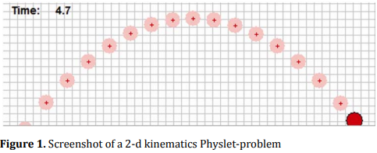
The first study
to compare the impact of simulations, sequences of printed simulation frames and conventional static diagrams on students' understanding of one-dimensional kinematics
pre-post quasi-experiment
students who learned from simulations or from printed sequences of simulation frames significantly outperformed their peers who learned one-dimensional kinematics from conventional static diagrams
more positive students' attitudes toward kinematics instruction
Notes:
In our study, we aimed to compare the impact of simulations, sequences of printed simulation frames and conventional static diagrams on students' understanding of one-dimensional kinematics. Our student sample consisted of three classes of middle years students (N=63; mostly 15 year olds). These three classes served as comparison groups in our pre-post quasi-experiment, whereby each of them has been assigned to one of the experimental treatments, i.e. media types. The results of the ANCOVA showed that students who learned from simulations or from printed sequences of simulation frames significantly outperformed their peers who learned one-dimensional kinematics from conventional static diagrams. Thereby, we have found that learning from sequences of simulation frames seems to be particularly effective for girls. The use of simulations or printed simulation frames has also proved to be associated with more positive students' attitudes towards kinematics instruction.

Slide 6
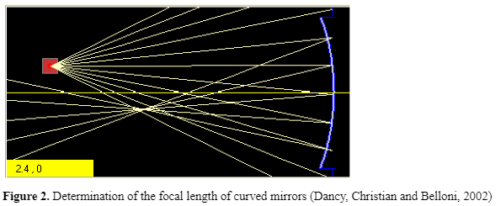
The second study
to explore the effect of teaching methods (traditional, static diagrams and interactive computer simulations) on student‘s understanding of lenses
pre-post quasi-experiment
statistically significant differences between the traditional teaching methods and simulation-based method
comparison between the traditional teaching method and static diagrams statistically non-significant
the interaction between the type of cognitive load and teaching method proved to be statistically significant
statistically significant effect has been found for the relevant cognitive load comparison between the traditional and simulation-based approaches.

Slide 7
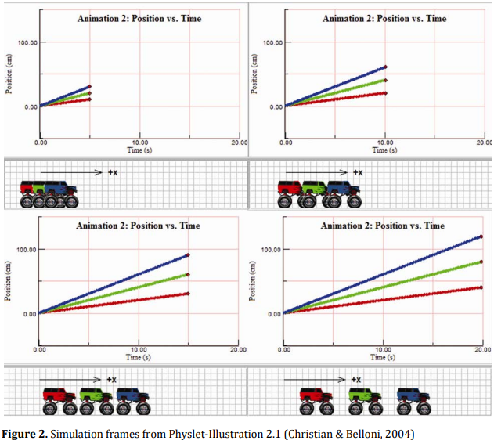
The third study
to investigate the factors that potentially influence the effectiveness of simulation-based learning (the effectiveness of teacher-centered and student-centered Physlet-based instruction about one-dimensional kinematics)
students from the TC approach outperformed their peers when it comes to conceptual understanding of kinematics
students from the students-centered approach were more successful in solving quantitative problems
The results of our study support the idea that a progression from TC to SC approach may be optimal for learning novel concepts.
Notes:
Within the teacher-centered approach the teacher ran and controlled the simulations, and students watched the simulations on the projection screen. In the student-centered approach the students had the opportunity to work through the simulations on their computers. At the posttest, students from the teacher-centered approach outperformed their peers when it comes to conceptual understanding of kinematics, but students from the students-centered approach were more successful in solving quantitative problems. The results of our study support the idea that a progression from teacher-centered to student-centered approach may be optimal for learning novel concepts.

Slide 8
Conclusion
Using visualizations in physics education
Cognitive load
Multimedia learning environment
Progression from TC to SC approach

Slide 9
Thank you ☺

