Slide 1
World Storytelling Day & Story SLAM

Slide 2
World Storytelling Day
WHAT: World Storytelling Day
WHY: Celebrates the art of storytelling
WHEN: Held on Spring equinox.
HOW: As many people as possible tell stories in as many languages as possible about a given theme.
WHERE: All over the world.
https://en.wikipedia.org/wiki/File:Wsdmatslarge.png
2015 theme – Wishes
https://en.wikipedia.org/wiki/World_Storytelling_Day

Slide 3
EXAMPLE STORY

Slide 4
HOW WILL WE CELEBRATE WORLD STORYTELLING DAY?
VIA a StorySLAM

Slide 5
WHAT IS A Story SLAM?
A live storytelling competition.
Slammers have a given time limit (usually 5 minutes) to tell a story based on a given theme.
Stories must be true, as remembered by the storyteller.
Stories are told, not read.
No notes.

Slide 6
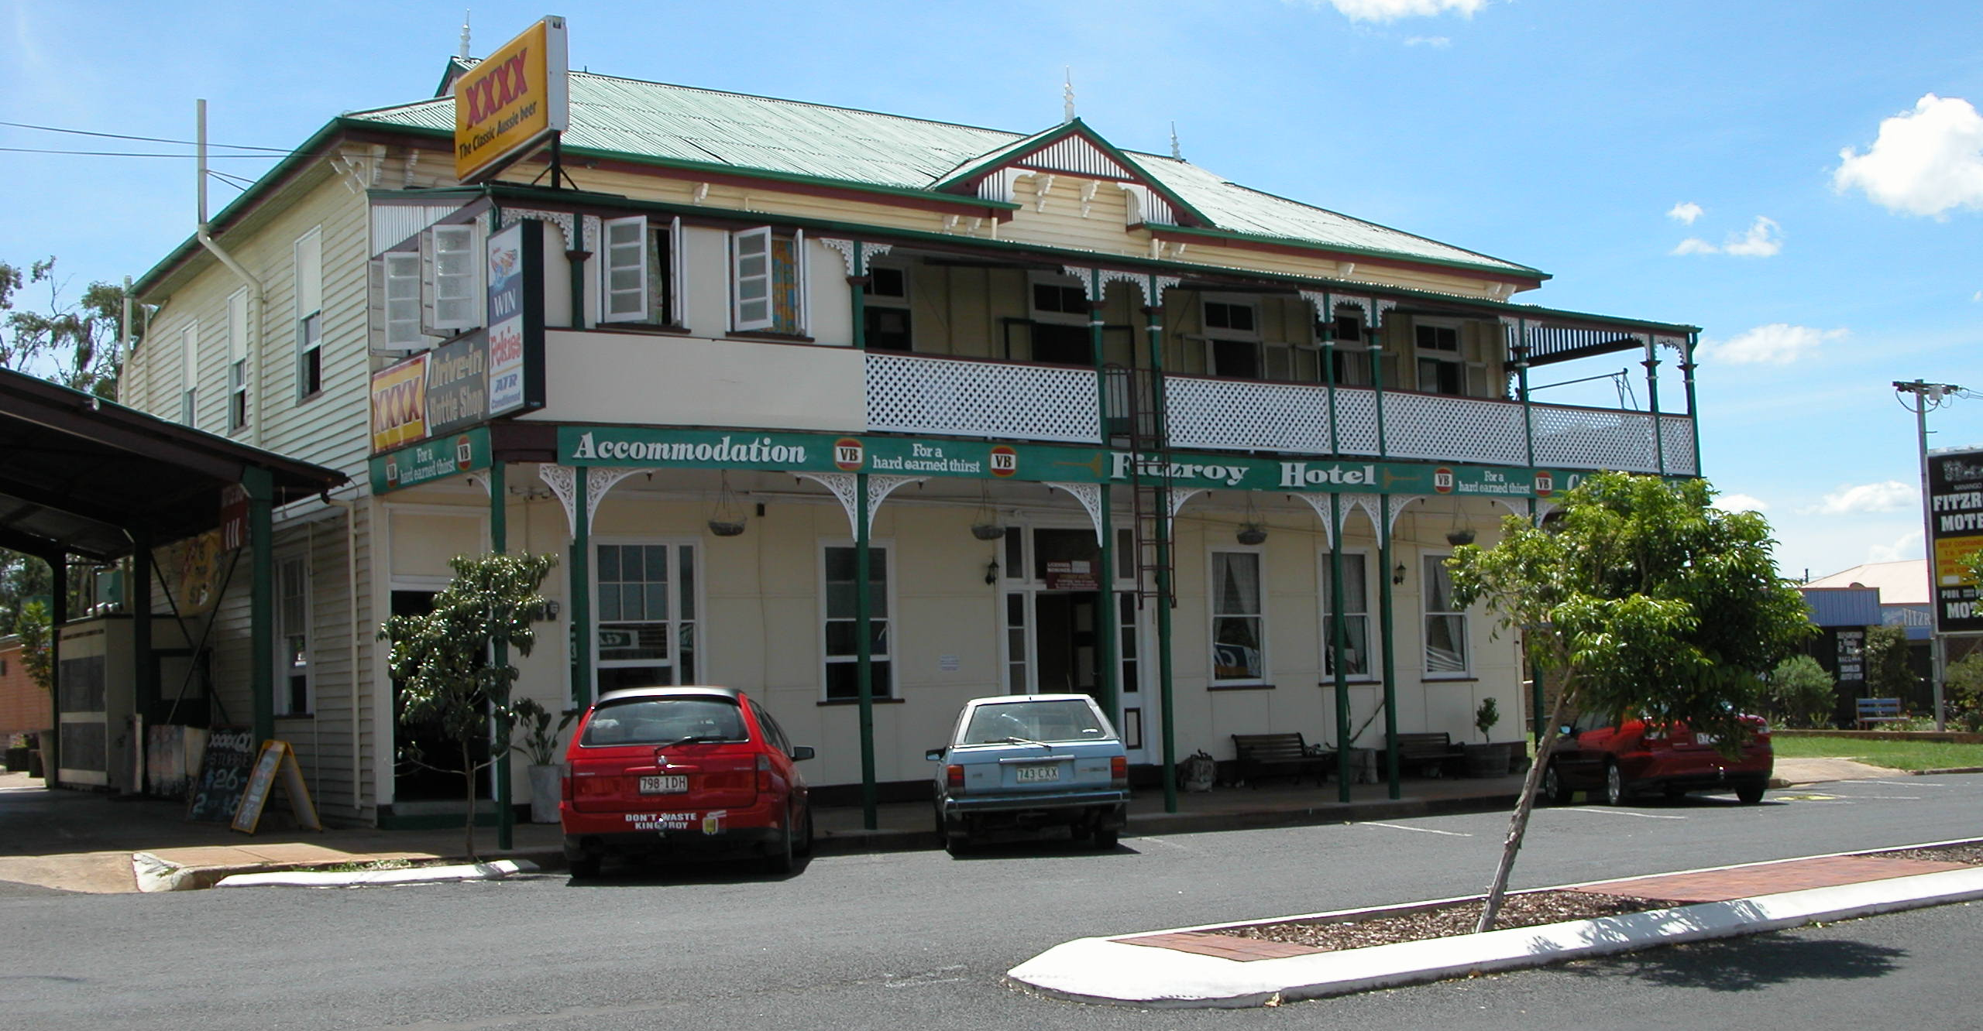
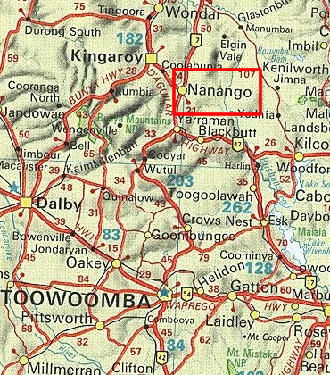
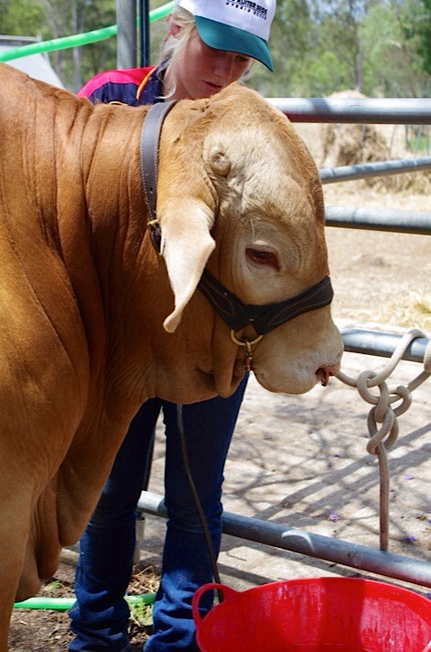
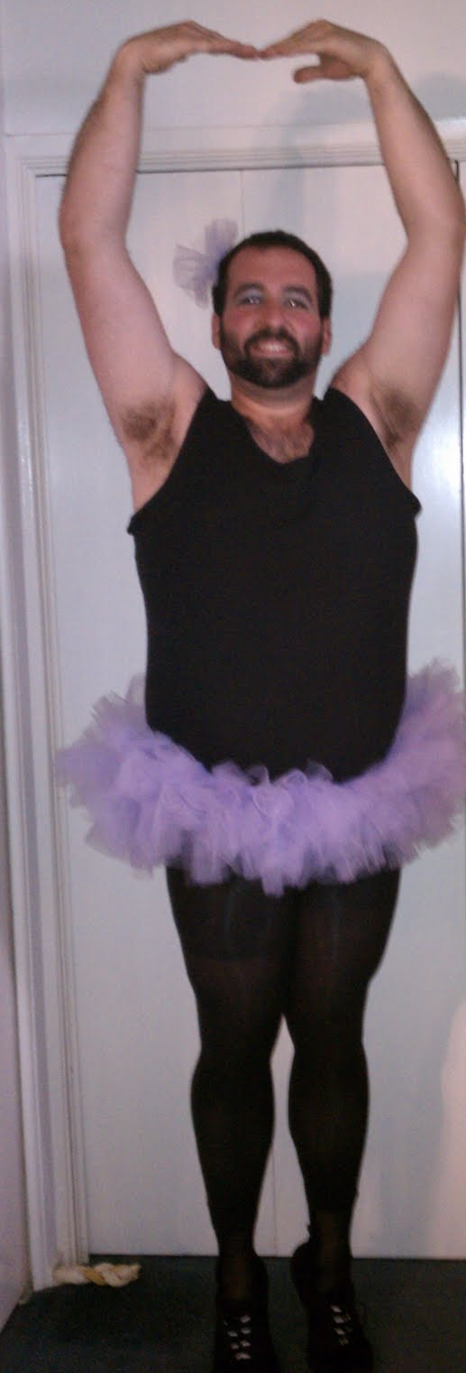
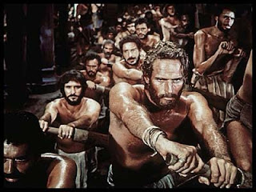
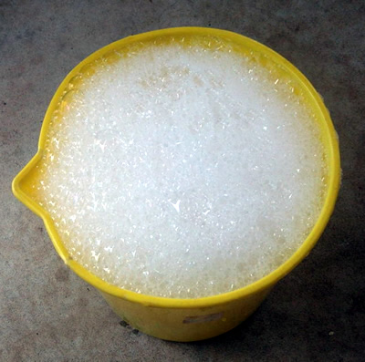
STORY SLAM

Slide 7
How will we Story SLAM?
LANGUAGES
3xANG
2xSLO
2xNEM
JUDGES
2 teachers
2 students
Activity
Delivery of practice stories
Holistic feedback about practice stories
??????
Languages?
Judges?
Judging criteria?

Slide 8
Tips for Story SLAM
Know your story by “heart”.
Avoid rote memorisation.
Know the first and last sentence of your story.
Start with a bang: a strong first sentence to grab the audience’s attention.
A good story will have a beginning, middle, and end, not necessarily in that order.
A good story will have a conflict and a resolution.
Let the audience know why what happens in your story is important to you.
http://abingtonareacommunityclassroom.wordpress.com/slam-in-the-summit/slam-rules-storytelling-tips/

Slide 9
Tips for Story SLAM
People love personal stories.
Your job is to make the audience care, and keep them on the edge of their seats.
Map out your story and know your destination so you won‘t get lost along the way.
Practice! So that you won‘t forget it and can be sure that your story is within the time limit.
Have fun!
http://abingtonareacommunityclassroom.wordpress.com/slam-in-the-summit/slam-rules-storytelling-tips/

Slide 10
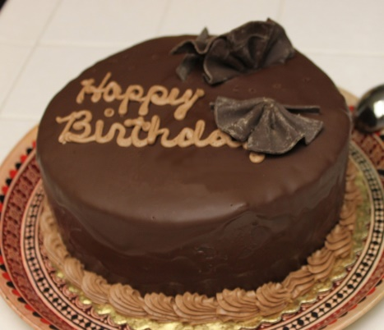
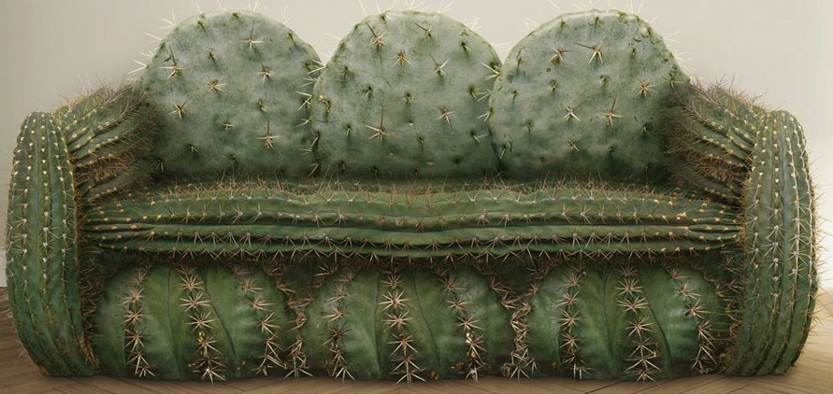
Tell a short story about one of the following…
Lake Bled
Chocolate Birthday Cake
Broken Arm
Social Networking
Uncomfortable couch

Slide 11
HOMEWORK Preparation for Story SLAM
Plan a short story about ?
The time limit is 1 – 3 minutes.
Try to follow all of the given tips for Story SLAM.

