Slide 1
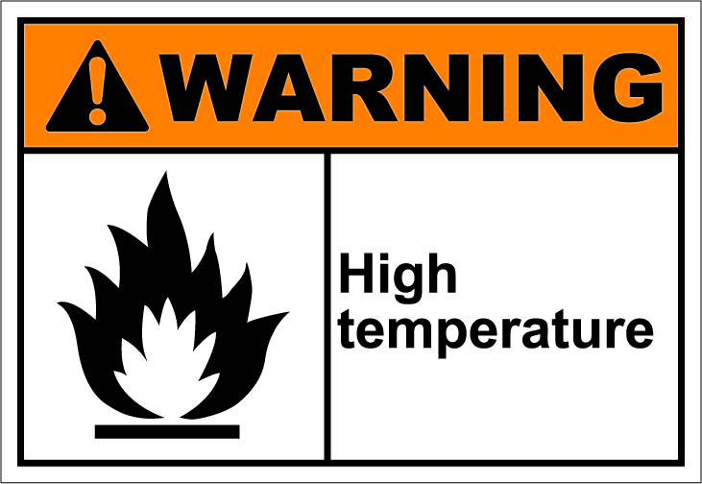
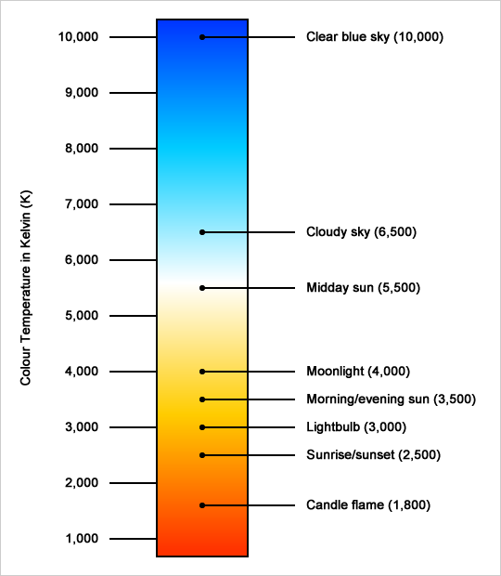
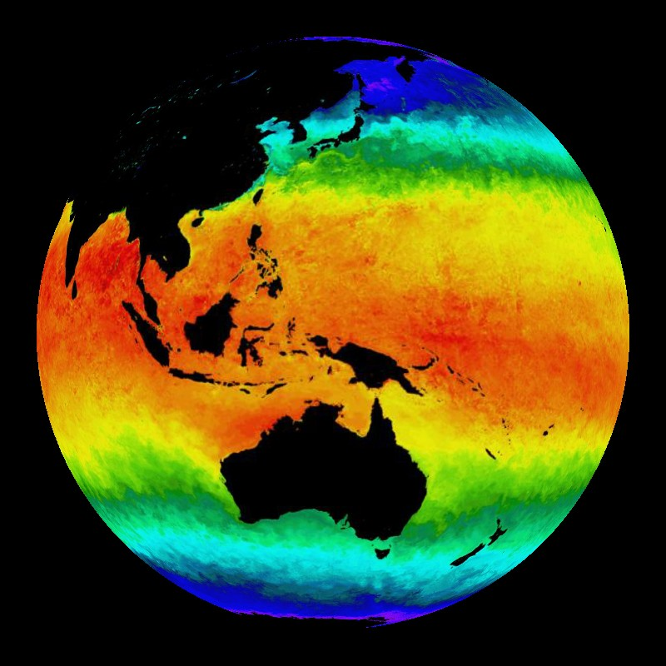

TEMPERATURE
http://www.electroschematics.com/
http://www.photographymad.com
http://sos.noaa.gov

Slide 2


Slide 3
What scales are used to measure TEMPERATURE?

Slide 4
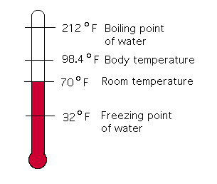
TEMPERATURE SCALES
Fahrenheit scale
Invented in 1724
Named after German physicist, Daniel Gariel Fahrenheit
Defined in terms of water:
  freezes at 32°F
  boils at 212°F (at 101.32 kPa)
Still used in USA and its territories
http://intermath.coe.uga.edu/dictnary/images/miscell/frnthrmtr.gif

Slide 5
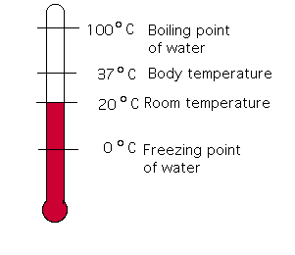
TEMPERATURE SCALES
Celsisus scale
Invented in 1742
Named after Swedish astronomer, Anders Celsius
Defined in terms of water:
  freezes at 0°C
  boils at 100°C (at 101.32 kPa)
Used worldwide except when Fahrenheit scale is predominant
http://intermath.coe.uga.edu/dictnary/images/miscell/frnthrmtr.gif

Slide 6
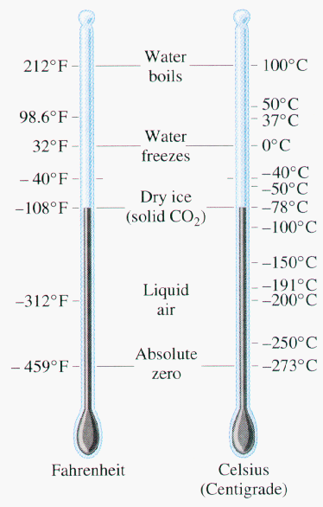
Converting between °F→°C & °C→°F
°F to °C
  Subtract 32
  Multiply by 5
  Divide by 9
°C to °F
  Multiply by 9
  Divide by 5
  Add 32
98.6 °F
  98.6 – 32 = 56.6
  66.6* 5 = 333
  333 / 9 = 37
So, 98.6 °F = 37 °C
100 °C
  100 * 9 = 900
  900 / 5 = 180
  180 + 32 = 212
So, 100 °C = 212 °F
http://nauticajonkepa.files.wordpress.com

Slide 7
For what types of measurements are the Fahrenheit and Celsisus scales usually used?
Weather forecasts
Baking & cooking
Clothes washing
Computer diagnostics
Health – fever or no fever?
Air temperature
Oven or Food temperature
Water temperature
CPU temperature
Body temperature

Slide 8
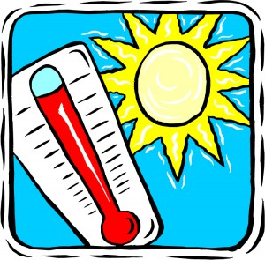
What is the “layman‘s” definition of temperature?
Temperature is a measure of how HOT or COLD something is.

Slide 9
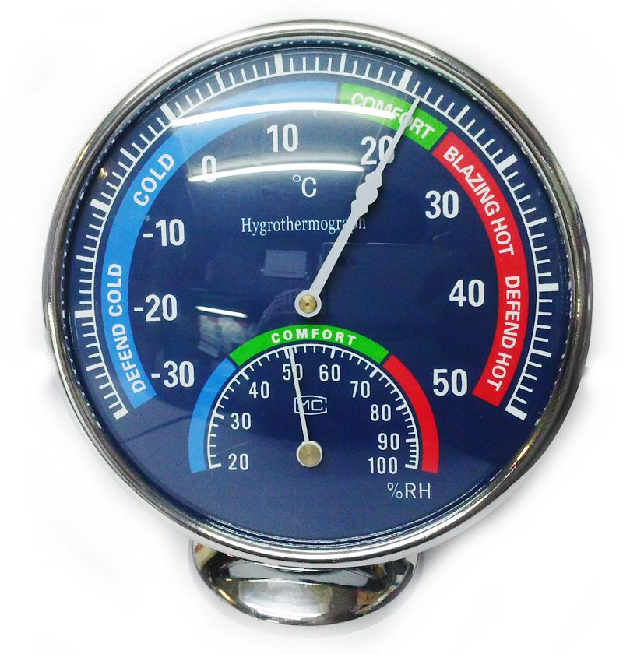
What is the “scientist‘s” definition of temperature?
Temperature refers to the kinetic energy of a substance‘s moving particles.
↓ temperature = slower movement
↑ temperature = faster movement
http://imshopping.rediff.com

Slide 10

THE SPEAKER SAID “zero degrees kelvin (0°K)”
– THIS IS INCORRECT
INSTEAD WE SAY “zero kelvin (0 K)”

Slide 11
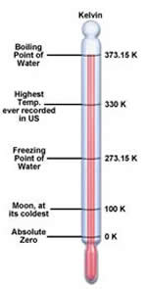
Temperature scales
Kelvin scale
Invented in 1848
Named after British engineer and physicist, William Thomson (1st Baron Kelvin)
Defined in terms of absolute zero which is the same for all substances
0 K = - 273.15°C
Kelvin is an SI base unit
http://www.differencebetween.info

