Slide 1
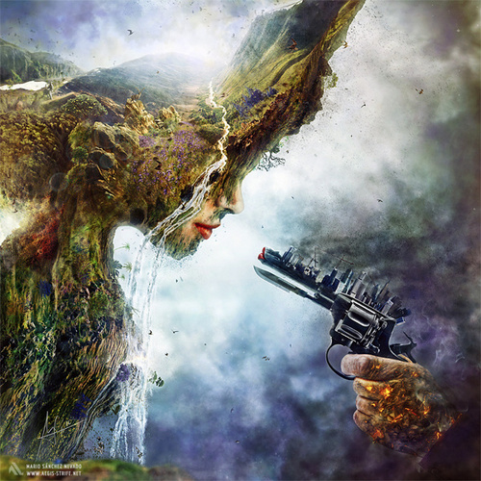
The environment

Slide 2
A few of the environmental issues we tend to ignore...
Climate change, global warming, fossil fuels, sea level rising, greenhouse gases, flooding, habitat destruction, illegal dumping, overfishing, marine pollution, whaling, deforestation, exploitation of natural resources, species extinction, poaching, wildlife trade, energy conservation, renewable energy, air quality, genetically modified food, pesticides, nuclear power, overpopulation, ozone depletion, water and air pollution, consumerism, mining, waste disposal, toxic waste...

Slide 3
So, what is global warming?
“None like it Hot” – Futurama / An Inconvenient Truth
https://www.youtube.com/watch?v=UIrzMMUmgqU

Slide 4
I’ve heard this a million times. Why should I care?
According to a National Geographic article by Brian Clark Howard (published - 31. 3. 2014):
“The world is not ready for the impacts of climate change, including more extreme weather and the likelihood that populated parts of the planet could be rendered uninhabitable, says the planet's leading body of climate scientists in a major new UN report.”

Slide 5
...and if that wasn’t bad enough...
“The 772 scientists who wrote and edited the report argue that world leaders have only a few years left to reduce carbon emissions enough to avoid catastrophic warming, which would produce significant sea level rise and large-scale shifts in temperatures that would dramatically disrupt human life and natural ecosystems.”
Taken from: http://news.nationalgeographic.com/news/2014/03/140331-ipcc-report-global-warming-climate-change-science/

Slide 6
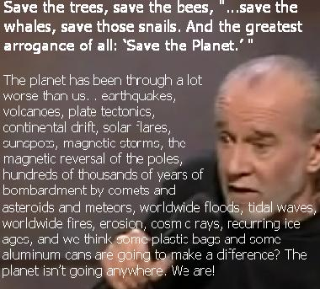
Although some people have a slightly different opinion...

Slide 7
Now it’s time to think...
Get into groups of 3 or 4.
Together try to come up with environmental demands / suggestions for your government or governments worldwide. What must they do to slow down / stop the damage we’re causing?
Choose one person in the group to report back to the class (I suggest you choose the person who contributed the least to the discussion ☺)

