Slide 1
Slovene school system
creche,kindergarten
2-6
6-15
primary school
secondary school
gymnasium, technical, vocational
15-19
Matura, school-leaving exams
19-23
university
(music, art, education)

Slide 2
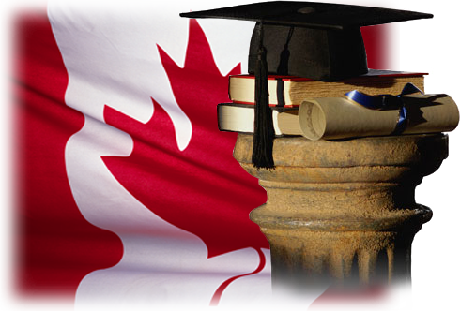
The Canadian School System

Slide 3
How Canadian Schools Work
Most children attend elementary school and then high school. Usually, children enter high school at about age 13 or 14. Some school systems have middle schools that children attend for two years before they enter high school.
Children between six and 16 must attend school and most of them go to public schools.
In elementary and high school, classes usually start in early September and end in late June.

Slide 4
There is usually a two-week vacation in December and a one-week vacation in either February or March.
Children attend school Monday to Friday, for about six hours a day. They usually bring their lunch to school, but sometimes return home for lunch if they live close to their school.

Slide 5
Possible Divisions
Pre-school (optional): age 4 – 5
Kindergarten: age 5
Elementary School: Grades 1 – 6 (age 6 – 11)
Middle / Junior High School: Grades 7 – 9 (age 12 – 14)
High School: Grades 10 – 12 (age 15 – 17 / 18)

Slide 6
Typical Classroom Environment

Slide 7
Most children in Canada attend public schools, although some attend private schools. Public schools do not charge school fees for children to attend and private schools do charge fees.
Boys and girls share classrooms and are taught together in most public schools. Teachers must be qualified and licensed to teach in the classroom. All academic teachers have at least one university degree and special training in education.

Slide 8
Language
The language of instruction in Canada is either English or French. If a student has difficulty in these languages, additional language training is usually available. In Quebec, almost all children must attend French-language schools.

Slide 9
Religion
A large number of religions are practiced in Canada. For this reason, religion does not play an active role in most regular public schools. Public schools usually teach children about the different religions of the world instead of providing instruction in one religion.
In some provinces, faith-based schools are available within the public school system. And there are many faith-based private school across Canada.

Slide 10
School Buses
Children often take school buses (provided by the school at little or no cost to parents) or public transportation to get them from home to school and back.

Slide 11
Report Cards
Report cards tell you how your child is performing in school. Depending on the province or territory in which you live, your child will receive a report card three to four times a year.

Slide 12
Extra-Curricular Activities
Extra-curricular activities are activities that take place outside of school hours—before school, after school or during lunch. These activities may include sports, hobbies, travel, leadership, arts or volunteer work.

Slide 13
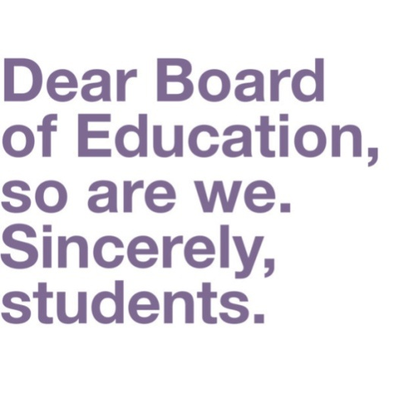
School Boards
School boards govern the work of public schools from nursery school to high school. Each public school in Canada belongs to a school board. Each private school decides on its own how it will run.

Slide 14
School board trustees are people elected to set policies about how public schools will operate.
Trustees hold meetings with the public to tell them of any plans that concern the schools. At these meetings, community members are welcome to voice their concerns about the school, the public school system or anything else about their children’s education.

Slide 15
Post-Secondary Education

Slide 16
College: community college, technical school, applied arts, applied science school (certificates, diplomas, associate degrees, bachelor’s degrees...)
University: undergraduate and postgraguate education (academic degrees in a variety of subjects)
Graduate School: academic certificates, diplomas and degrees (i.e. Master’s Degree, Ph. D)

Slide 17
A worldwide truth...

Slide 18
Sources:
http://www.cic.gc.ca/english/newcomers/before-education-schools.asp
http://www.cic.gc.ca/english/newcomers/before-education-classroom.asp

Slide 19
British school system
creche,nursery school
2-5
5-11
primary school
secondary school
11-16
GCSE /O-level exams
16-18
Preparing for
university
College of further education (technical)
A-level exams
18-22/23
university/college(music, art, education)

Slide 20
American school system
2-5
nursery school, kindergarten
6-11
elementary school
junior high
11-16
senior high
16-18
university/college
18-22/23

Slide 21
state schools : public/independent schools
comprehensive, grammar school
single-sex schools
co-educational schools
boarding schools,campus
grant/scholarship + loan
obligatory/compulsory/mandatory education
electives
tuition/course fee
you graduate from high school if you have enough units (e.g. 120 hours of classes)
a degree (if you have enough credits)
Expressions

