Slide 1
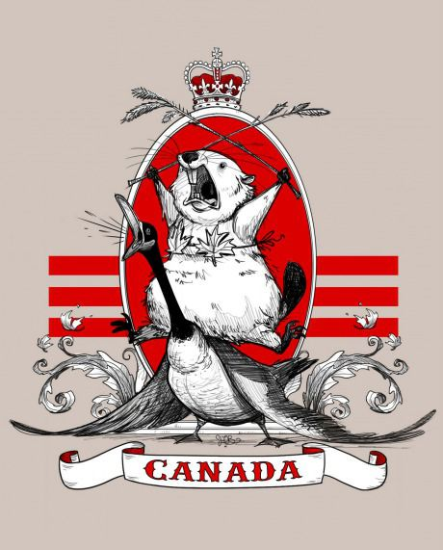
So, what do you know about Canada, eh?

Slide 2
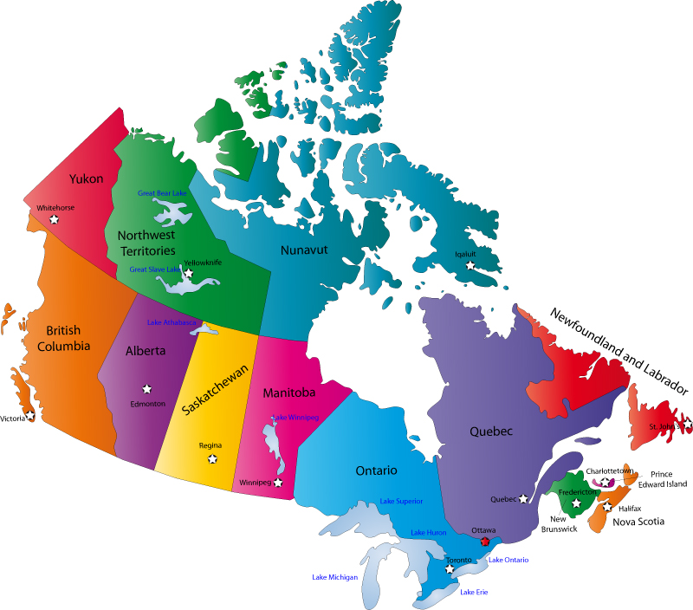

Slide 3
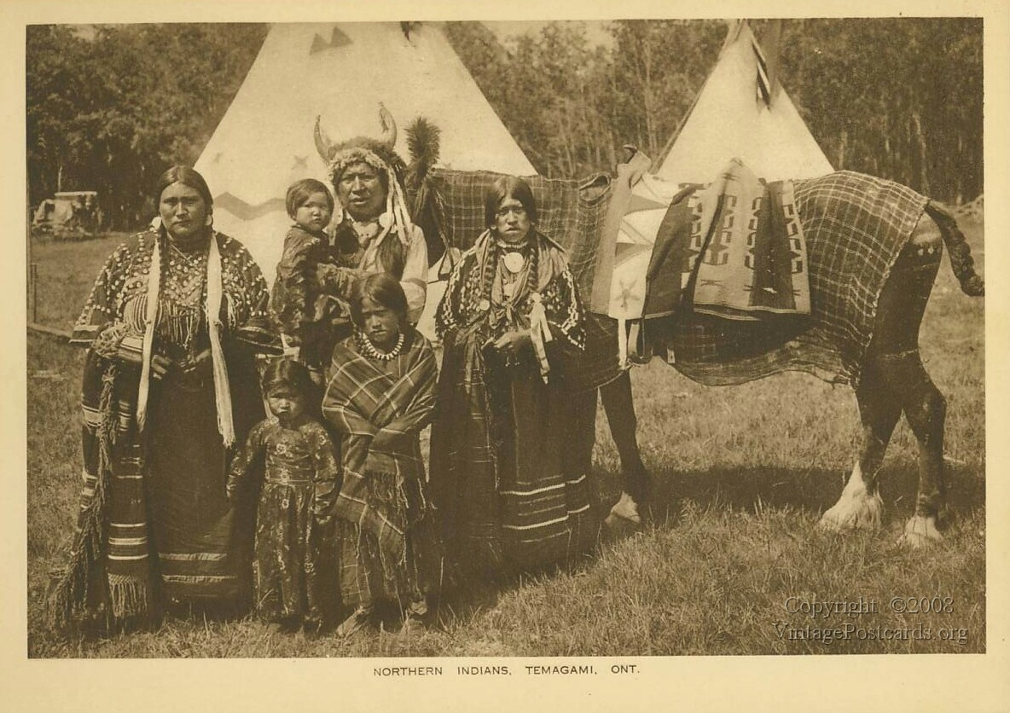
Northern Indians, Temagami, Ontario

Slide 4
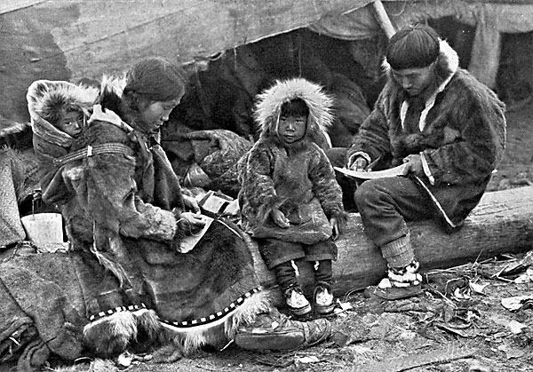
Inuit Family

Slide 5
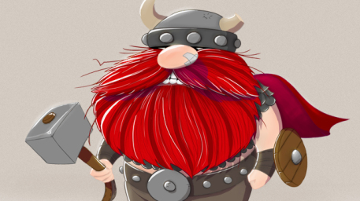
The First Europeans in Canada

Slide 6
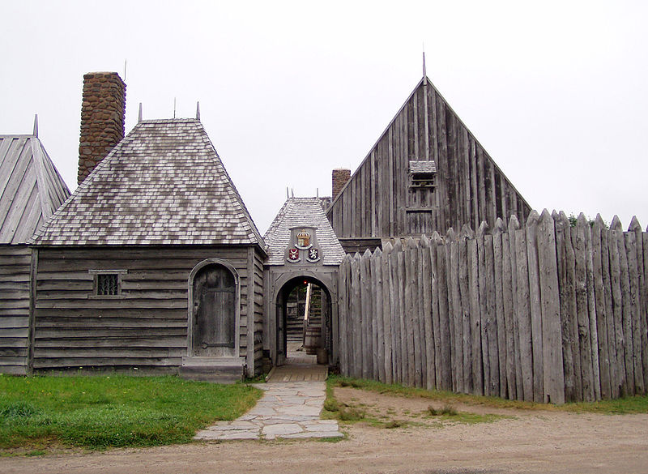
Port Royal - Today

Slide 7
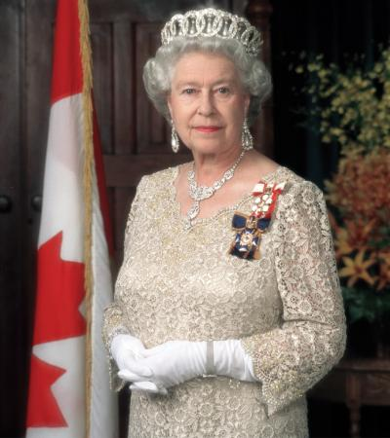
Yeah, she was our Queen too ☺

Slide 8
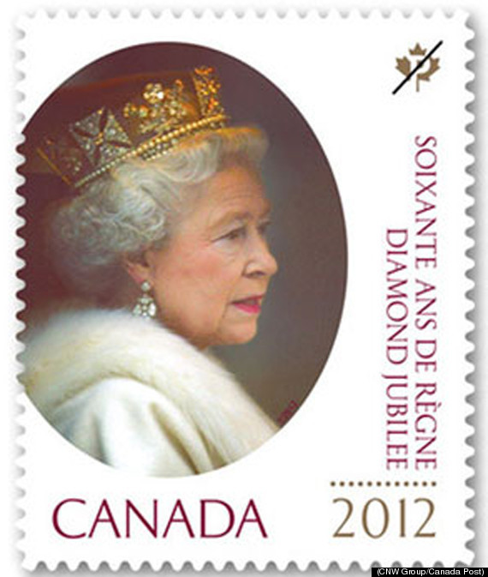
You can still find her everywhere...

Slide 9
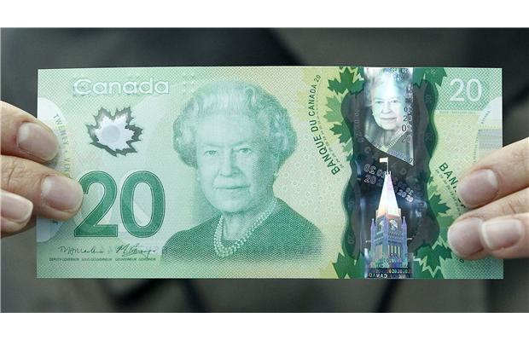
...no really, everywhere...

Slide 10
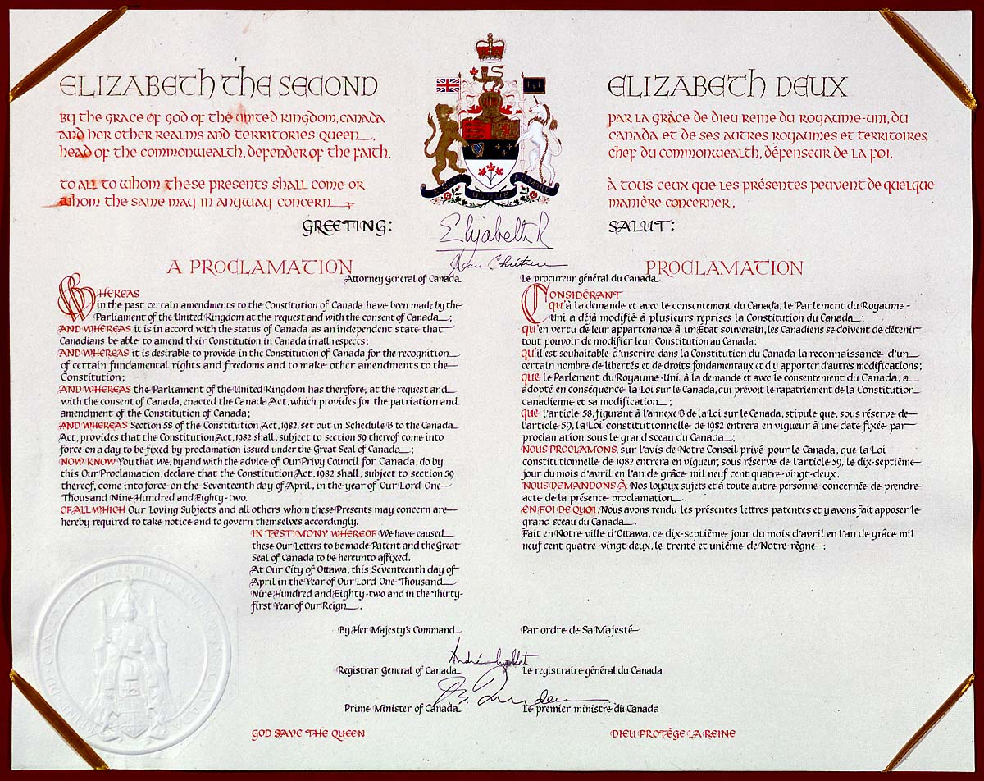
Free at last!

Slide 11
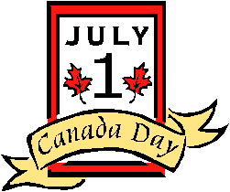
We celebrate our independence day on July 1st!

Slide 12
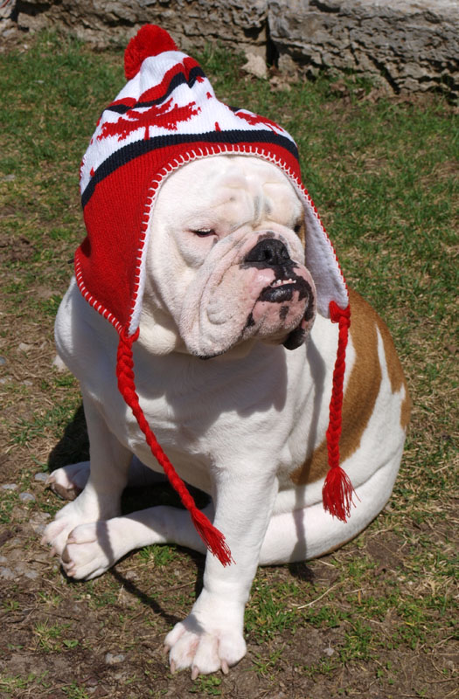
...although some people take it more seriously than others...

Slide 13
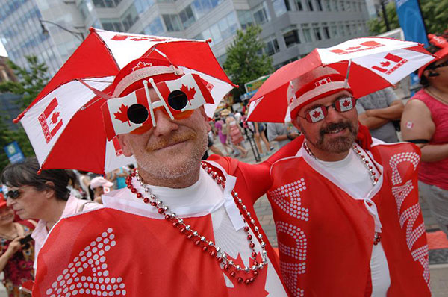
I mean, really seriously...

Slide 14
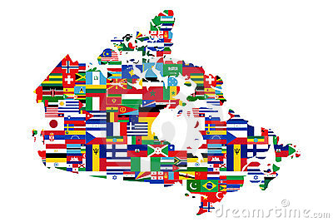
Saying you’re Canadian doesn’t mean much...

Slide 15
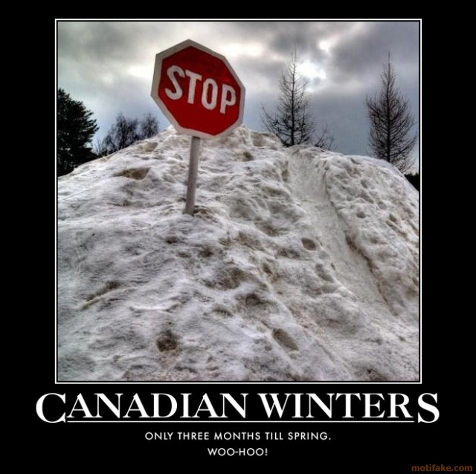
The Great Canadian Quiz

Slide 16
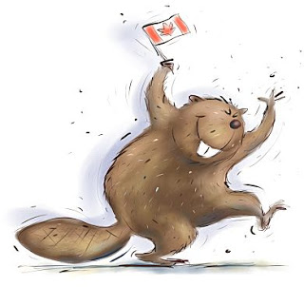
#1. Canada’s National Animal

Slide 17
But then...what’s a LOON?

Slide 18
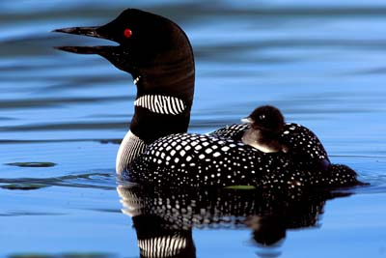
This is a LOON

Slide 19
They sound a little like this...
http://www.youtube.com/watch?v=Hw1It3AlXmQ

Slide 20
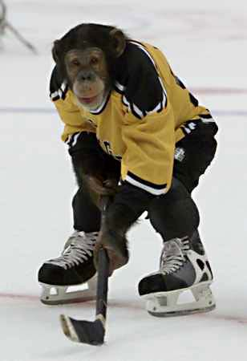
#2. Canada’s National Winter Sport

Slide 21
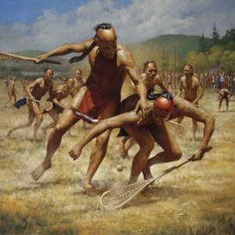
Lacrosse is not a new sport

Slide 22
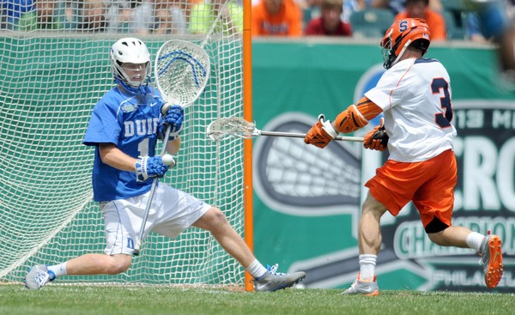
Maybe this looks more familiar

Slide 23
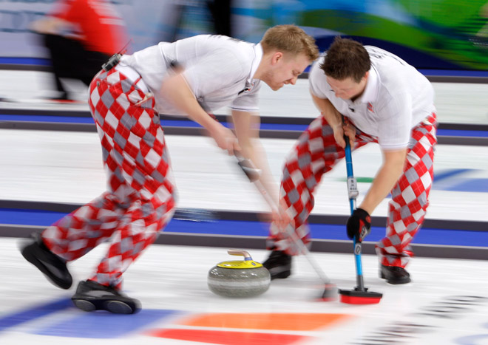
Curling...not an adrenaline sport

Slide 24
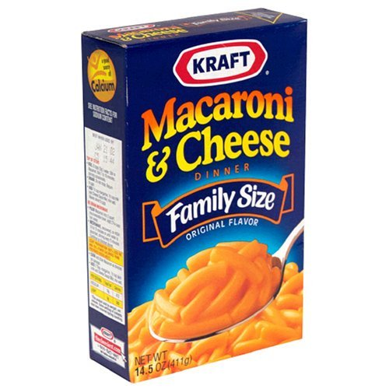
#3. We have a specific Macaroni and Cheese in mind

Slide 25
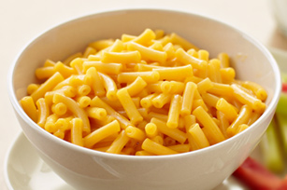
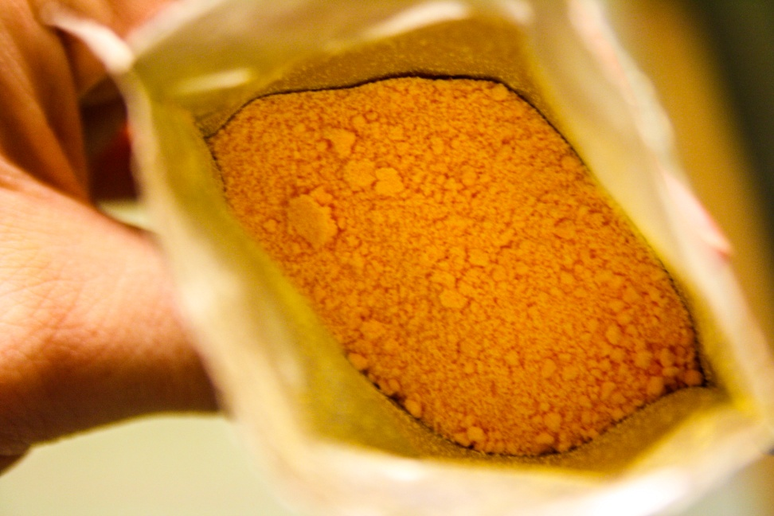
I can’t believe I used to eat this stuff...

Slide 26
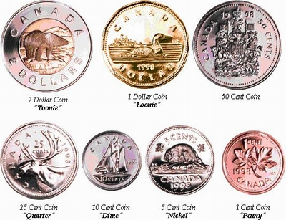
#4. We love our money so much, we named each and every coin ☺

Slide 27
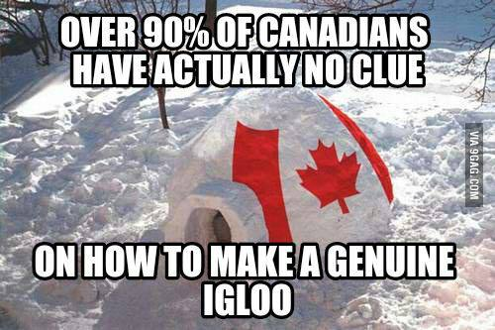
#5. Oh, come on. Really?

Slide 28
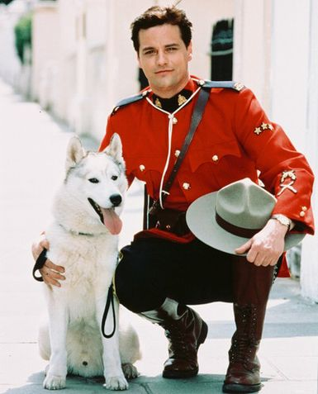
#6. The Royal Canadian Mounted Police

Slide 29
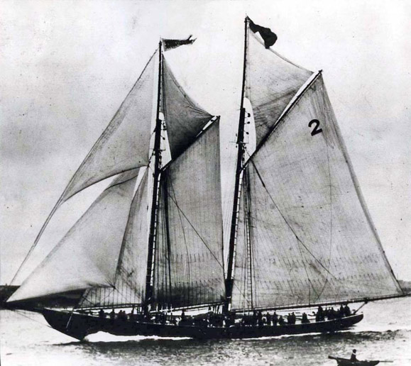
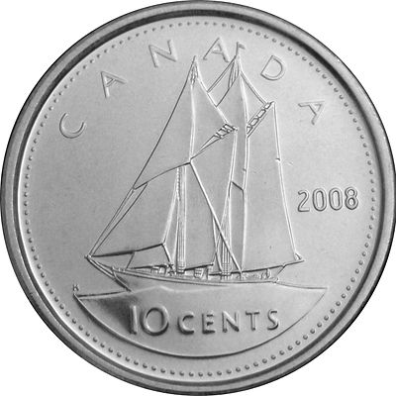
#7. The Bluenose
(why does everyone always say RED?)

Slide 30
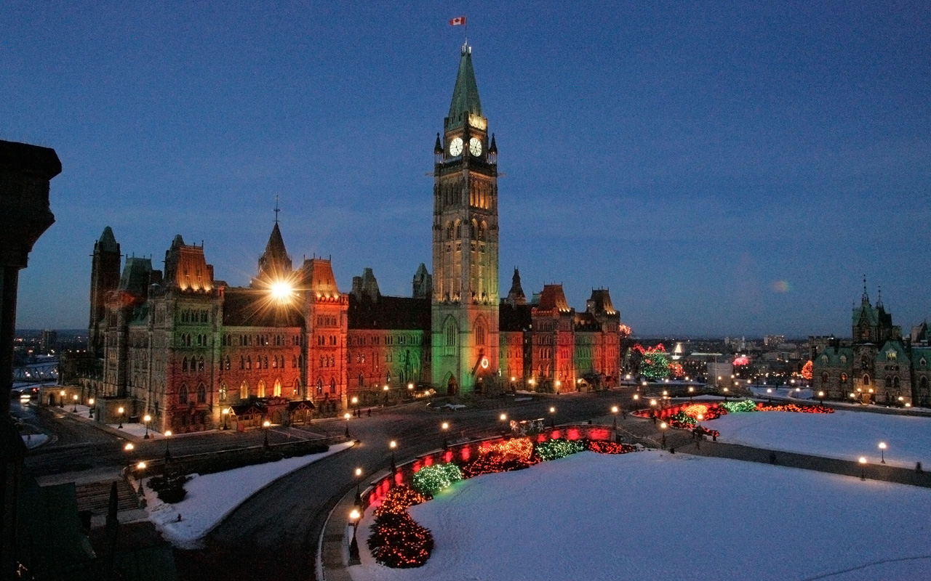
#8. Ottawa, of course.
(For those of you who slept through geography.)

Slide 31
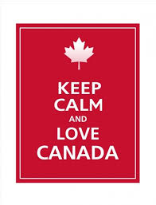
So, to finish off, I’d just like to say...

