Slide 1
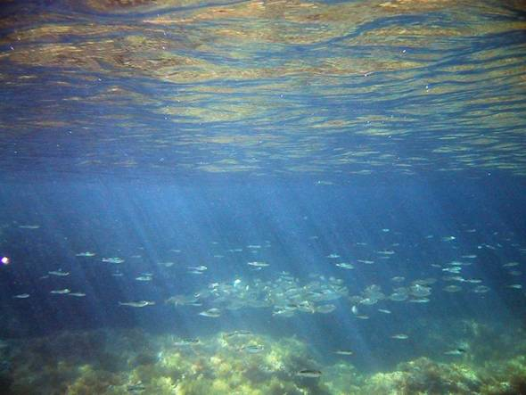
NARAVA V UČILNICI ali
KAKO “ZGRADITI” MODEL
Mojca Čepič
Pedagoška fakulteta
Univerza v Ljubljani

Slide 2
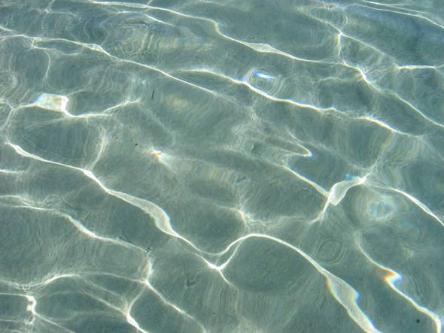
O čem
Kaj imenujemo model?
Katerim kriterijem mora zadostiti?
Kako ga naredimo?
Dva primera
  transport vode v drevesih
  svetlobni curki pod vodo

Slide 3
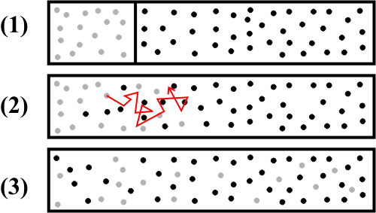
Kaj je to MODEL v fiziki?
- miselni model
Notes:
ugotavljanje dogajanja – posebej, ker je pogosto posredno

Slide 4
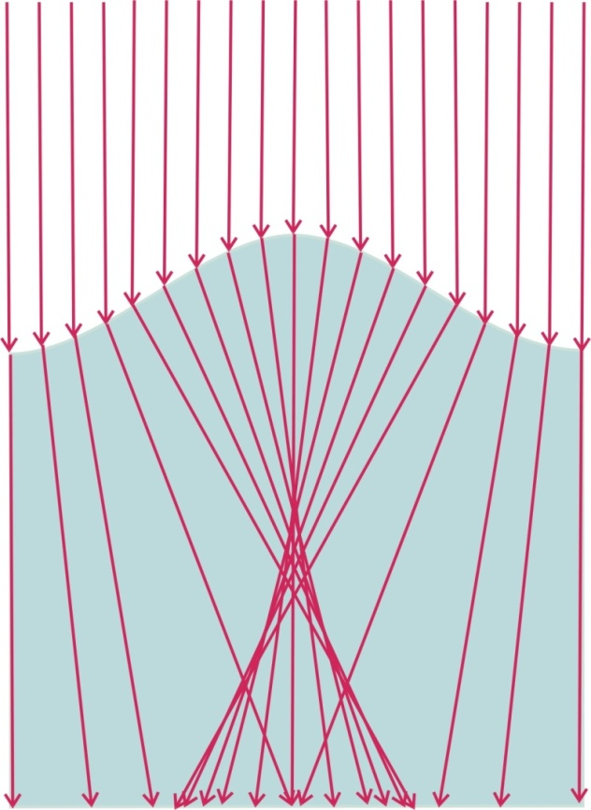
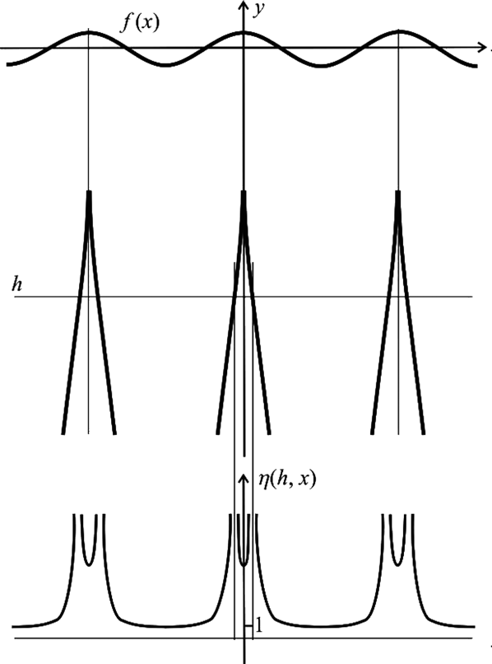
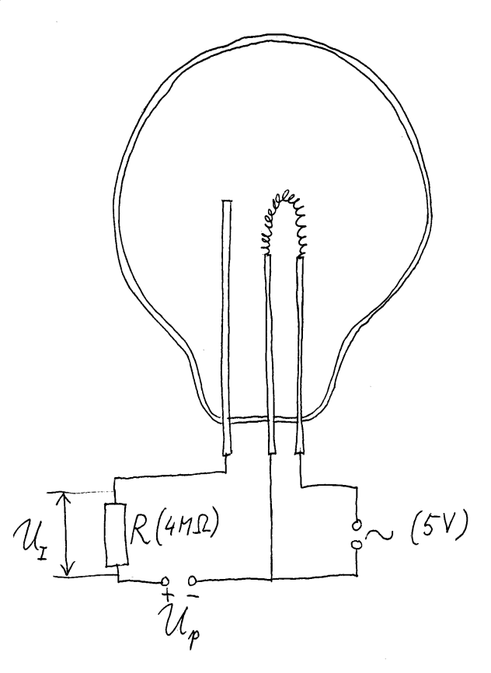
Kaj je to MODEL v fiziki?
- miselni model
- grafična predstavitev
skica: G. Planinšič
Notes:
ugotavljanje dogajanja – posebej, ker je pogosto posredno

Slide 5
Kaj je to MODEL v fiziki?
- miselni model
- grafična predstavitev
- matematični model
Notes:
ugotavljanje dogajanja – posebej, ker je pogosto posredno

Slide 6
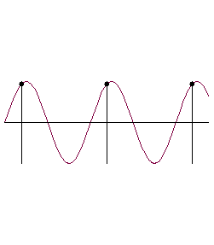
Kaj je to MODEL v fiziki?
- miselni model
- grafična predstavitev
- matematični model
- računalniški model (simulacija, animacija)
Notes:
ugotavljanje dogajanja – posebej, ker je pogosto posredno

Slide 7
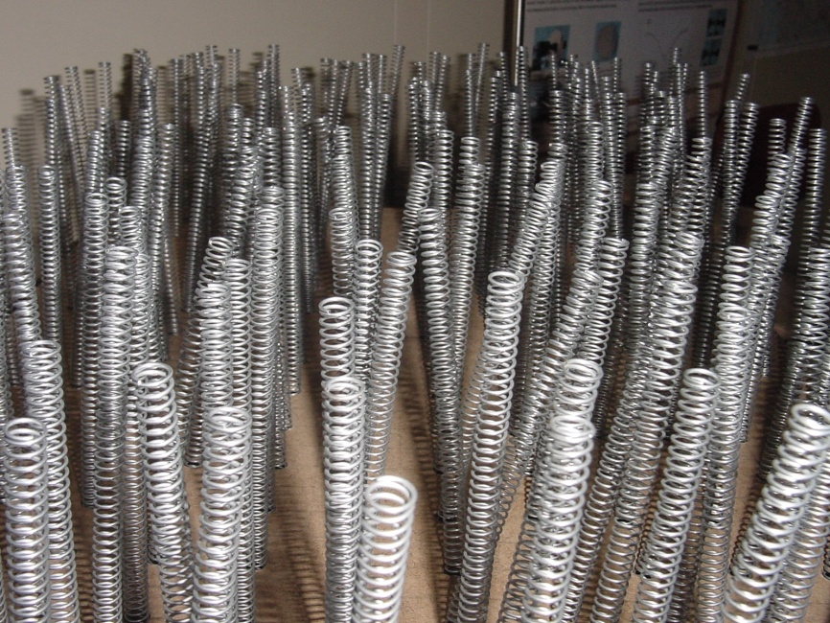
Kaj je to MODEL v fiziki?
- miselni model
- grafična predstavitev
- matematični model
- računalniški model (simulacija, animacija)
- (mehanski) model, učilo
Notes:
ugotavljanje dogajanja – posebej, ker je pogosto posredno

Slide 8
Na kaj moramo biti pozorni
Lahko temelji na istih naravoslovnih konceptih kot pojav sam
Lahko temelji na analognih pojavih
Z modelom je mogoče eksperimentalno pokazati za pojav značilne koncepte
Strokovni temelji ne smejo presegati znanja učencev
Z modelom lahko načrtno eksperimentiramo

Slide 9
POJAV – svetlobna mreža
- opazovanje
- opisovanje dogajanja
- ugotavljanje možnih razlag za dogajanje
- oblikovanje hipotez(e)
- preverjanje hipotez(e) → MODEL
Notes:
ugotavljanje dogajanja – posebej, ker je pogosto posredno

Slide 10
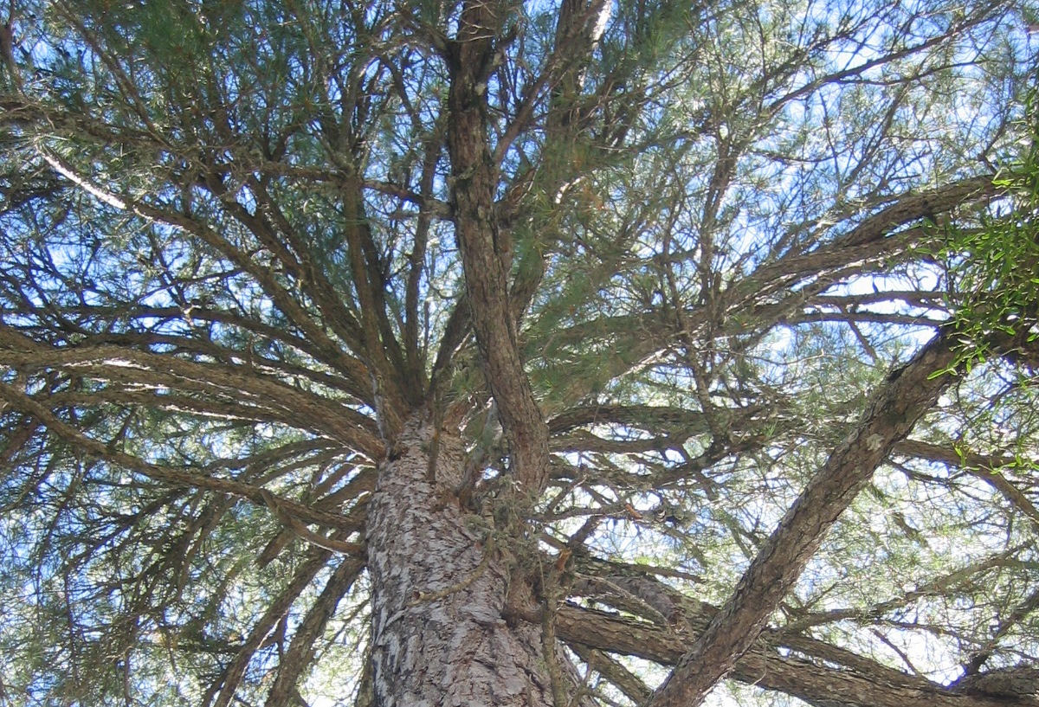

Slide 11
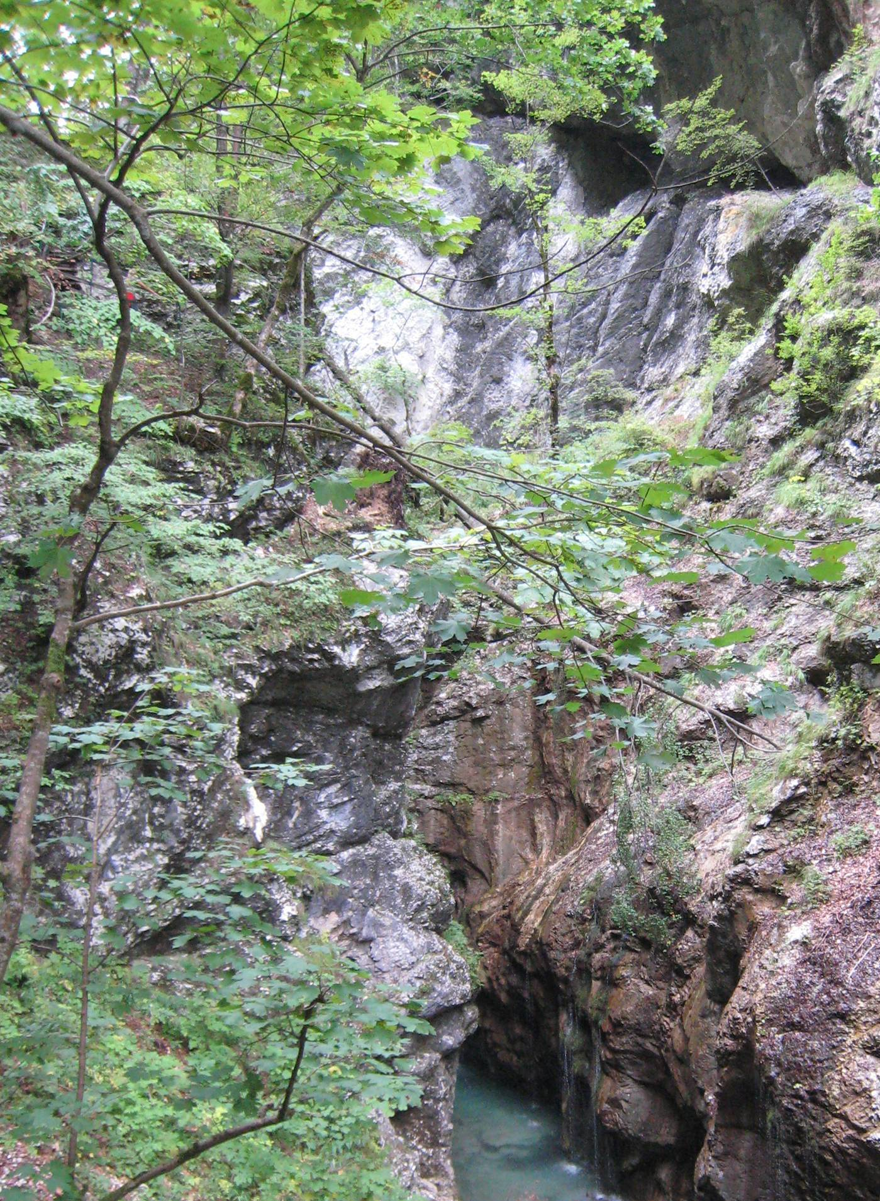
Kaj potrebujejo listi?
kisik
hrana
svetloba
ogljikov dioksid
voda
“prebava” oz.
celično dihanje
fotosinteza

Slide 12
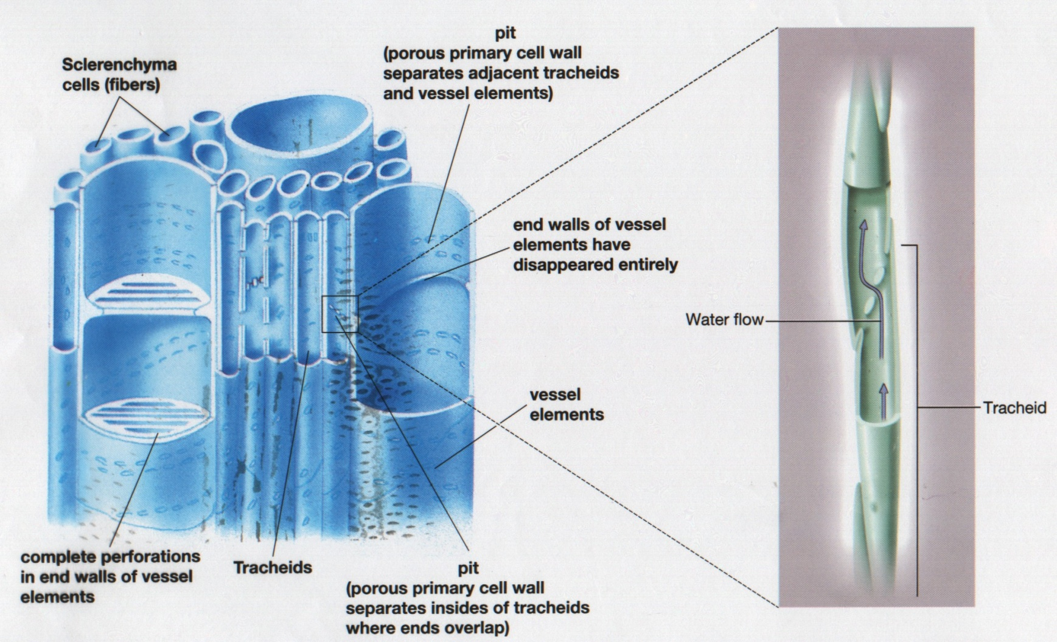
Kaj vemo o transportu vode?
Ksilem – sistem mrtvih cevi z radijem od 10 do 100 µm.
Notes:
Why so high tree rare? This is an extrem, however, trees, higher than 10 m are not a rarity. One can find them in parks, forest, gardens, practically everywhere providing the climate is enough mild and humid, and the winds are not too strong.
However, for a physicist it is a bunch of curious phenomena, some of them are not understood even today.

Slide 13


Vlek vode – kaj skrbi fizika?
Ksilem – sistem mrtvih cevi z radijem od 10 do 100 µm.
NI AKTIVNE POMOČI STRUKTURE
Ksilemski radiji od 10 do 100 µm.
Kapilarni dvig dosega 3 m.
kapilarni vlek
Notes:
Why so high tree rare? This is an extrem, however, trees, higher than 10 m are not a rarity. One can find them in parks, forest, gardens, practically everywhere providing the climate is enough mild and humid, and the winds are not too strong.
However, for a physicist it is a bunch of curious phenomena, some of them are not understood even today.

Slide 14
Vlek vode – kaj skrbi fizika?
izhlapevanje
- stik voda-zrak
- relativna vlažnost
Če je ksilem iz mrtvih celic, ga je mogoče
modelirati iz “mrtvih” komponent.
J.M. Vilalta, JBE (2003)
Notes:
Why so high tree rare? This is an extrem, however, trees, higher than 10 m are not a rarity. One can find them in parks, forest, gardens, practically everywhere providing the climate is enough mild and humid, and the winds are not too strong.
However, for a physicist it is a bunch of curious phenomena, some of them are not understood even today.

Slide 15
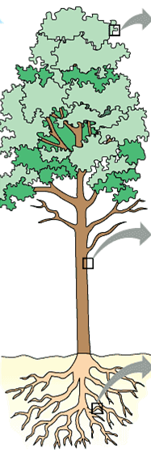
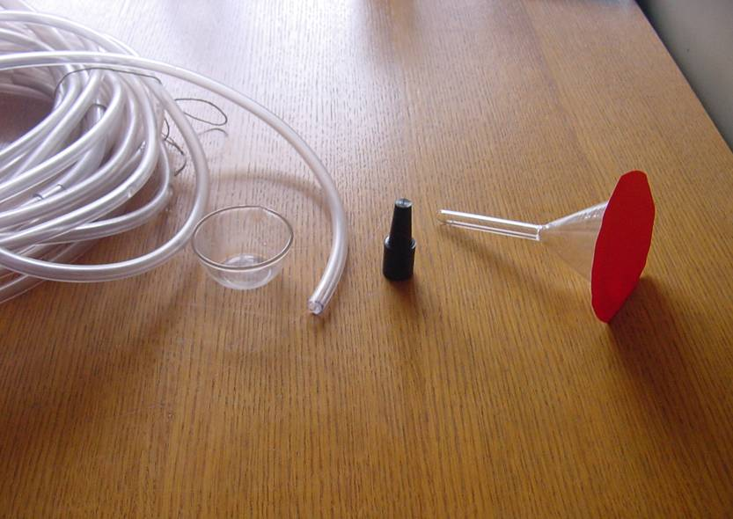
Kaj potrebujemo za laboratorijsko drevo?
- Membrana
- Cev
- Vodni rezervoar
Merilna oprema:
Termometer
Higrometer
Tehtnica
Barometer
Notes:
Why so high tree rare? This is an extrem, however, trees, higher than 10 m are not a rarity. One can find them in parks, forest, gardens, practically everywhere providing the climate is enough mild and humid, and the winds are not too strong.
However, for a physicist it is a bunch of curious phenomena, some of them are not understood even today.

Slide 16
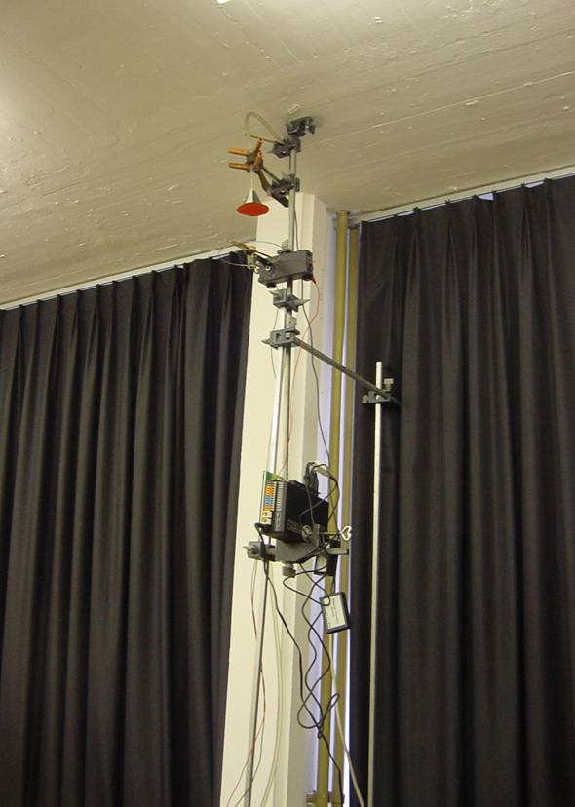
Kako torej narediti model drevesa?
Notes:
Why so high tree rare? This is an extrem, however, trees, higher than 10 m are not a rarity. One can find them in parks, forest, gardens, practically everywhere providing the climate is enough mild and humid, and the winds are not too strong.
However, for a physicist it is a bunch of curious phenomena, some of them are not understood even today.

Slide 17
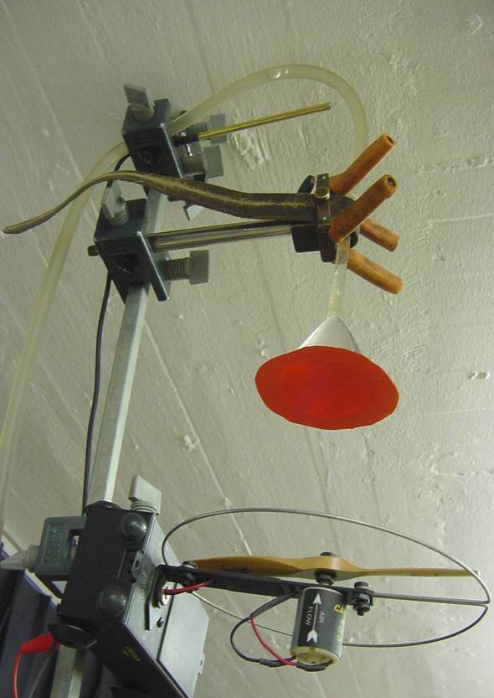
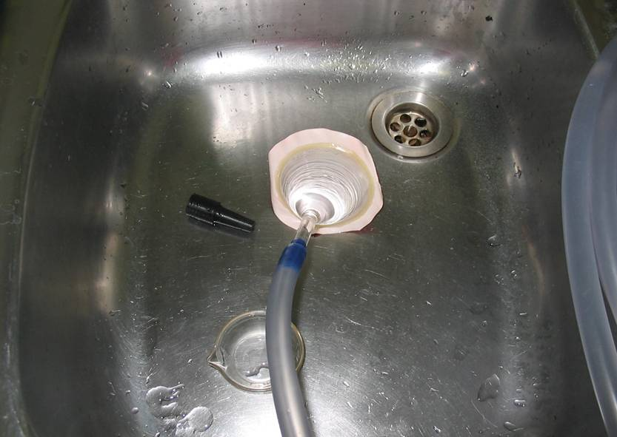
List
Notes:
Why so high tree rare? This is an extrem, however, trees, higher than 10 m are not a rarity. One can find them in parks, forest, gardens, practically everywhere providing the climate is enough mild and humid, and the winds are not too strong.
However, for a physicist it is a bunch of curious phenomena, some of them are not understood even today.

Slide 18
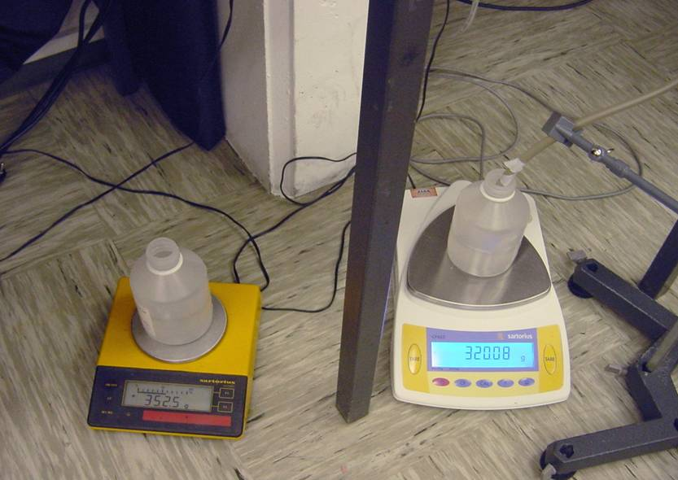
Korenine
Notes:
Why so high tree rare? This is an extrem, however, trees, higher than 10 m are not a rarity. One can find them in parks, forest, gardens, practically everywhere providing the climate is enough mild and humid, and the winds are not too strong.
However, for a physicist it is a bunch of curious phenomena, some of them are not understood even today.

Slide 19
Rezultati
Izhlapevanje
Susman et al, Phys. Ed. 2011
Notes:
Why so high tree rare? This is an extrem, however, trees, higher than 10 m are not a rarity. One can find them in parks, forest, gardens, practically everywhere providing the climate is enough mild and humid, and the winds are not too strong.
However, for a physicist it is a bunch of curious phenomena, some of them are not understood even today.

Slide 20
Rezultati
Vpliv vlažnosti in temperature
Notes:
Why so high tree rare? This is an extrem, however, trees, higher than 10 m are not a rarity. One can find them in parks, forest, gardens, practically everywhere providing the climate is enough mild and humid, and the winds are not too strong.
However, for a physicist it is a bunch of curious phenomena, some of them are not understood even today.

Slide 21
Curki svetlobe pod vodo
Notes:
I would like to discuss two faces of one phenomenon: The picture here is stolen from the internet and is called – underwater rays. Anybody seeing this picture would agree that this is a nice description. However,

Slide 22
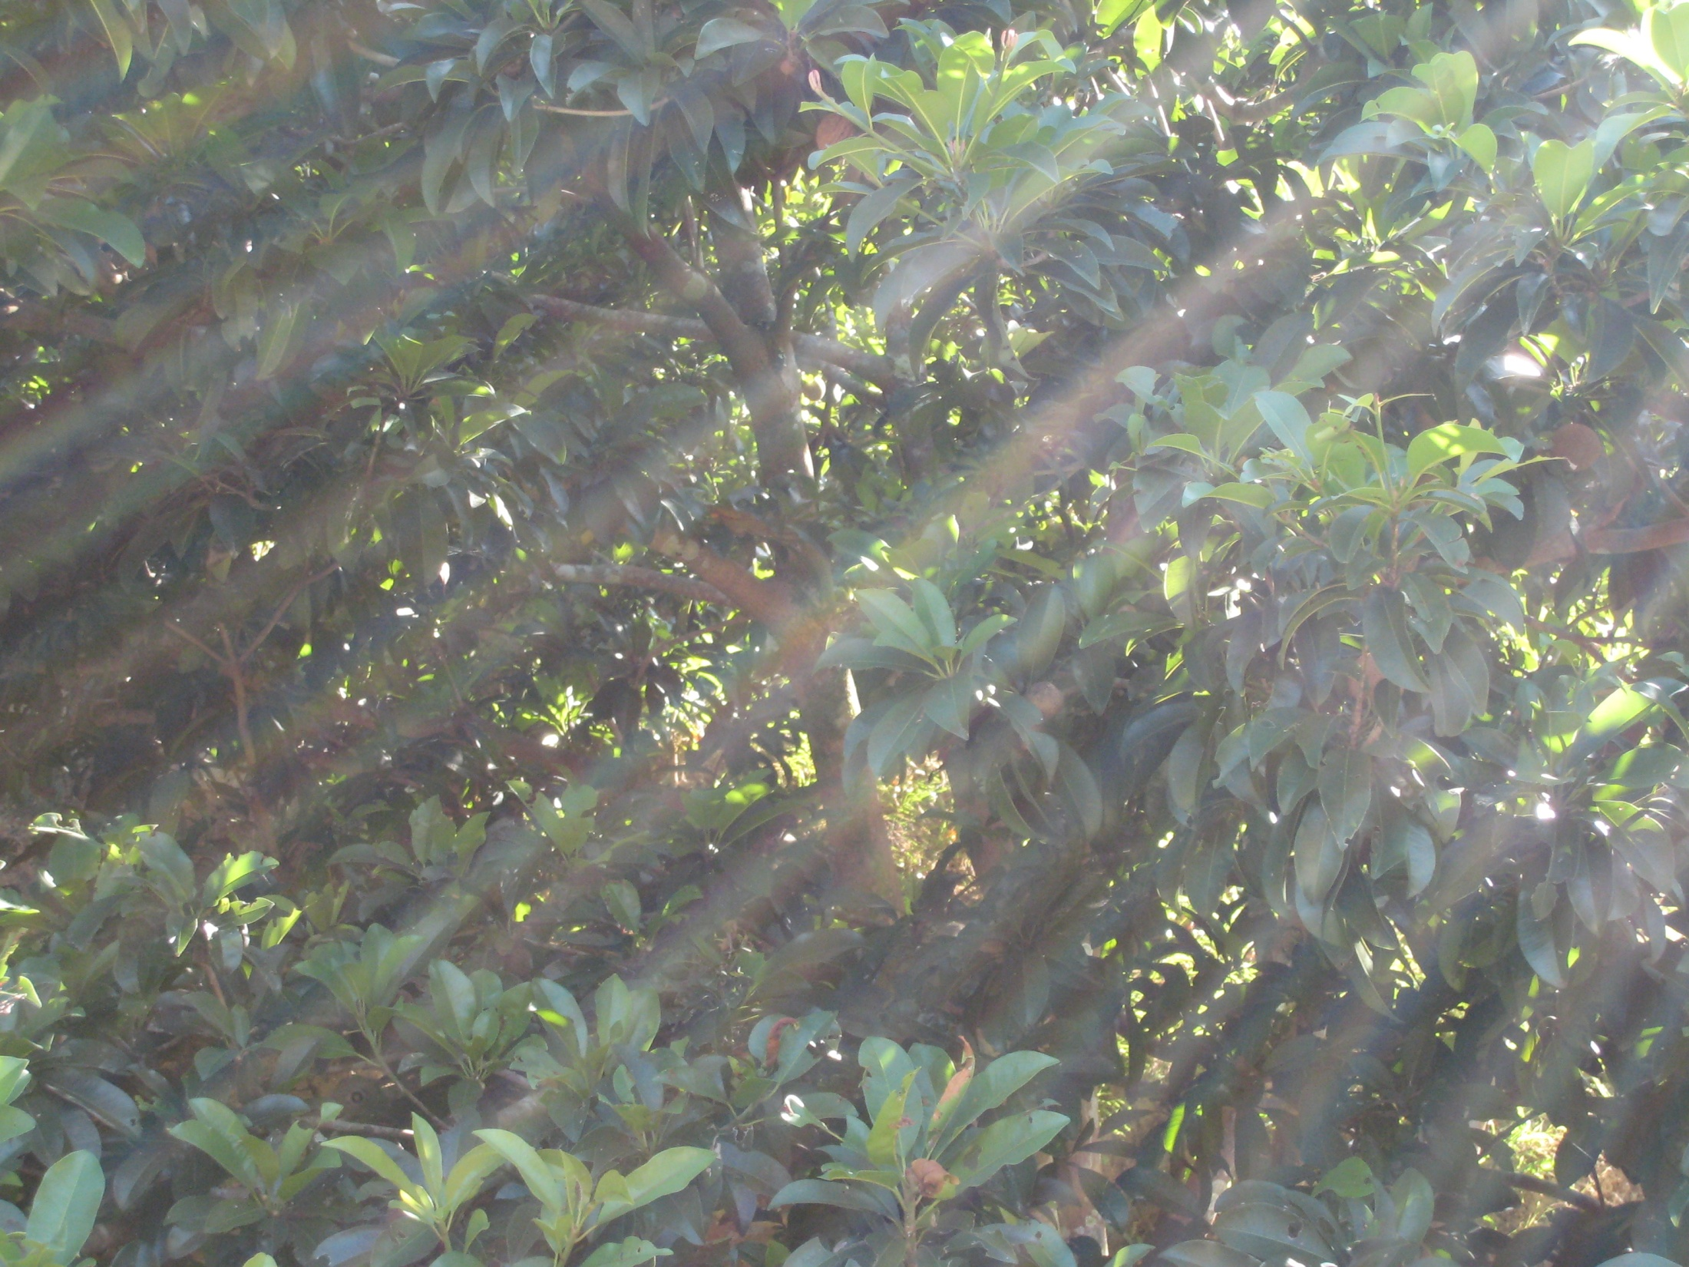
Svetlobni curki v meglenem jutru
Notes:
In everyday life we observe rays commonly after the rain, when the sunlight starts to peer through the holes between the clouds. Artists used this as a motivation, people stare at the sky enthusiastic because of bauty...
but let us turn back to physics...

Slide 23
Mreža svetlobnih lis
Notes:
thpresents the same thing observed from above, the phenomenon here is called “the caustic network”....everybody has seen this in the swimming pool, at the bottom of the relatively shallow see or the lake, when the water is not still. If not, you are invited to take a look later down in front of the hotel, there is a swiming pool.

Slide 24


Ali imata kaj skupnega?
Sipanje svetlobe na majhnih delcih
Toda
Svetlobni curki nastajajo zaradi odprtin med listi
Vodna površina je prosojna v celoti
Notes:
Do light rays above us on the sky and bellow the water surface – the underwater rays have anything in common?
Yes, they look the same....
They are seen only in the muddy water or the foggy air
However, the origin is quite different
the first question where the suspicion about the origin arises is
- where are the holes at the water surface? Observing the photo, one may even find them – however, the mirror like reginos are actually the regions similar to the mirrors at the police stations. Form bellow there is amirror, form above the light is not reflected ... there is no holes and no origin for that type of the underwater rays
At the intersections of rays and the bottom, the vivid bright lines are formed – the caustic network

Slide 25

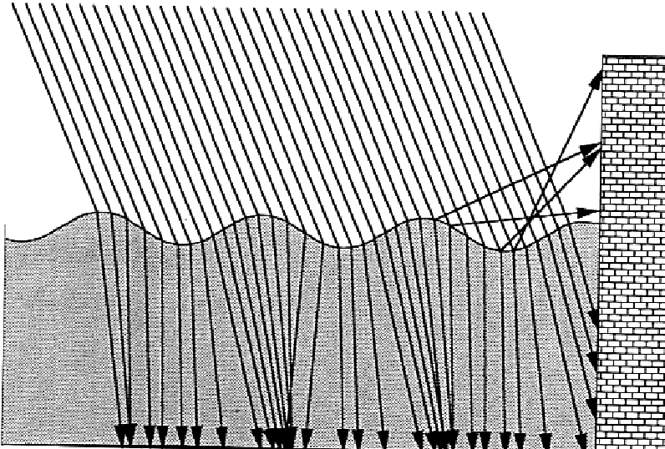
Mreža svetlobnih lis
- valovita površina deluje kot leče
DK Lynch, W Livingstone,
Light and color in nature, 2001
Notes:
The caustic network is best observed at the bottom of the pool or at the shallow water above the sand. What is the most common explanation for the caustic network. Curly surfaces due to waves form a set of converging and idverging lenses... and the picture like this one is commonly added. Although the picture seen here is perfectly correct it might lead (especially together with words) to false understanding of students. Students are generally familiar with focal points of lenses, considered obvioulsy only for rays very near the optical axes. For larege distances form the axes, for largere incident angles the life is not so simple anymore.

Slide 26
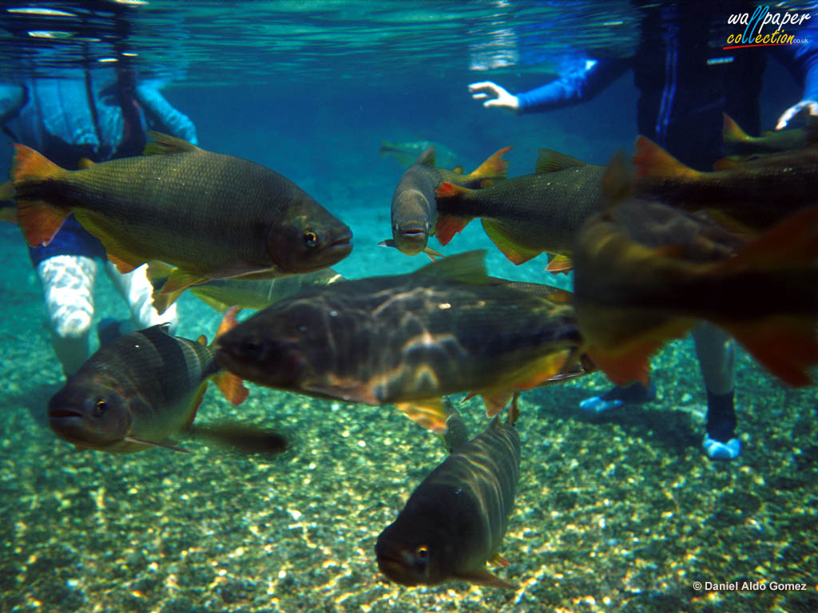
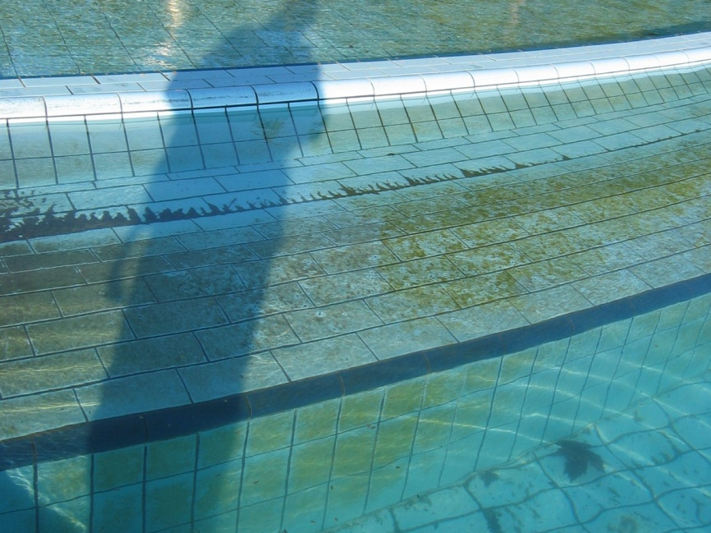
Zakaj potem svetlobni curki?
- Zakaj najdemo svetlobne lise na različnih globinah?
- Zakaj se nadaljujejo na navpičnih stenah?
Notes:
However, there are another issues that rule out such a simple understanding. One lens has one focal point (in this simple form). However – the caustic network is always present irrsepctive of wanelength and relatid properties of the “converging” lens. The bright lines appear at different height, they ebven continue at the vertical walls as seen at the lower left picture which was taken during the winter and therefore the water is so ugly muddy.

Slide 27
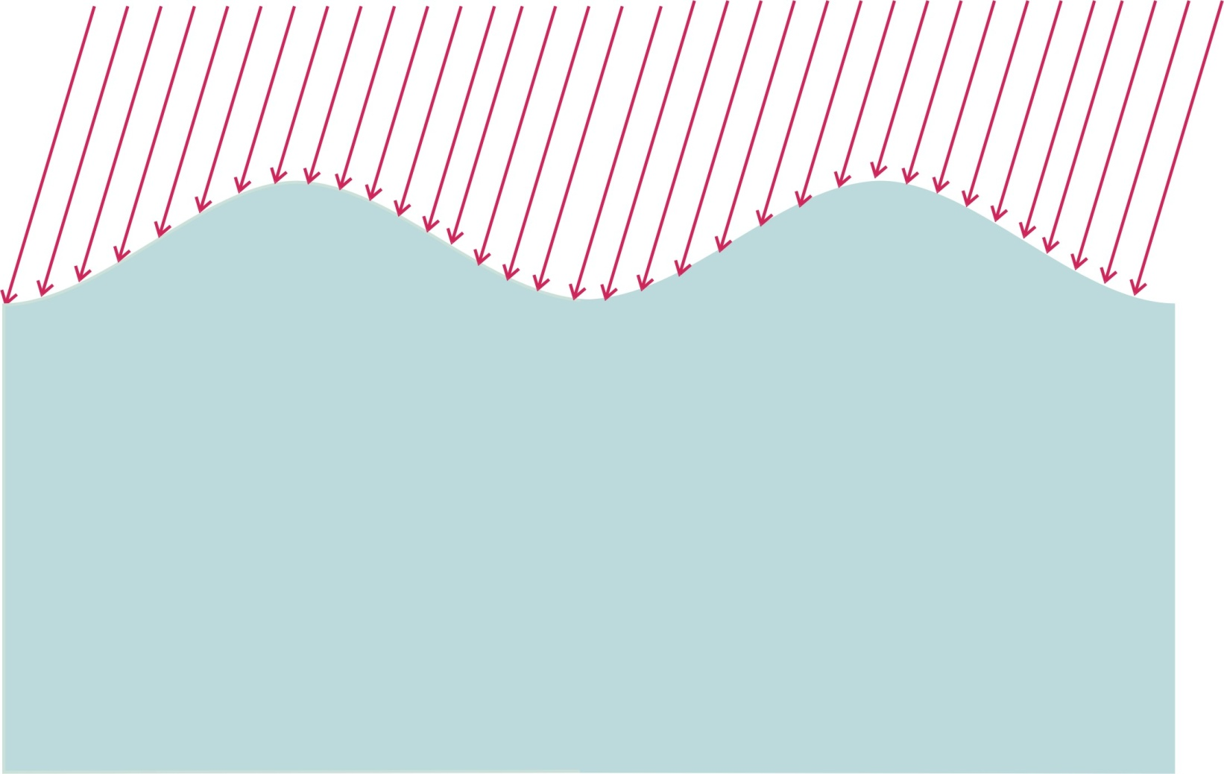
Kaj ponuja razmislek?
Notes:
First idea is that the radius of the wavy water surface vary.

Slide 28

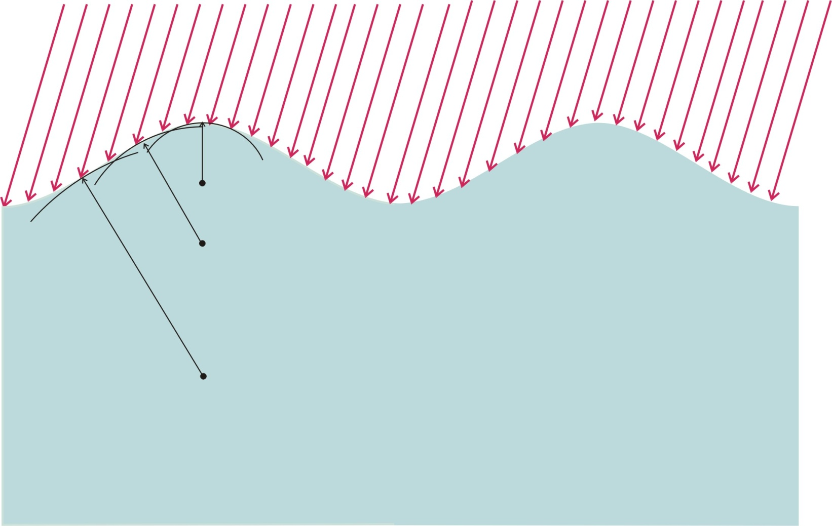
Razmislek
Ukrivljenost površine se spreminja, zato tudi gorišče
Notes:
Radious is the smallest at the top and increases ... however, the calculation of the curvature requires higher mathematical skills ... or the blind formula is used, which I personally do not like... Even more

Slide 29
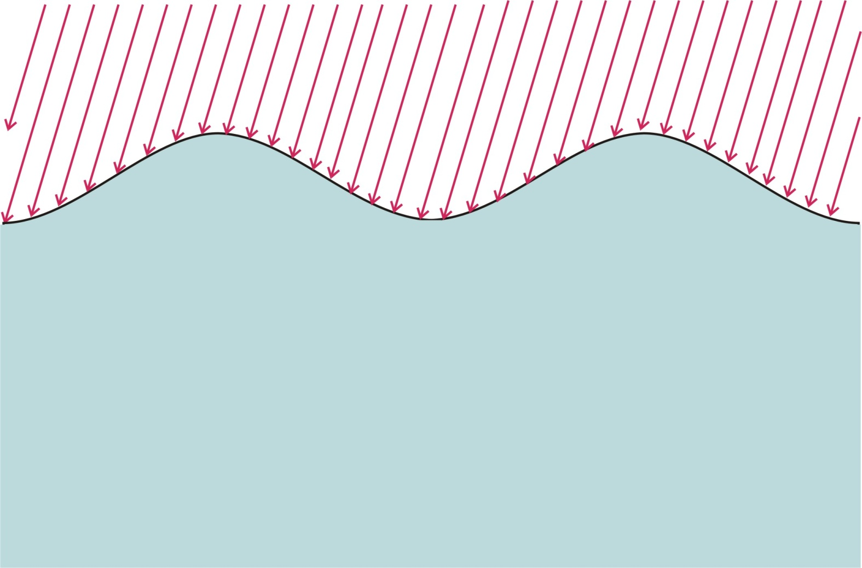
Geometrijski pristop
enačba površine

Slide 30
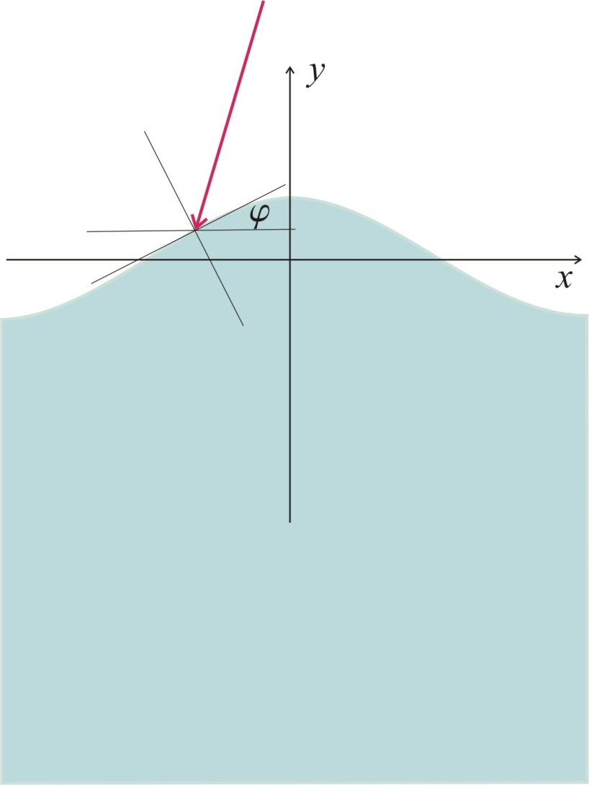
Naklon površine
- enačba površine:
- naklon površine:

Slide 31
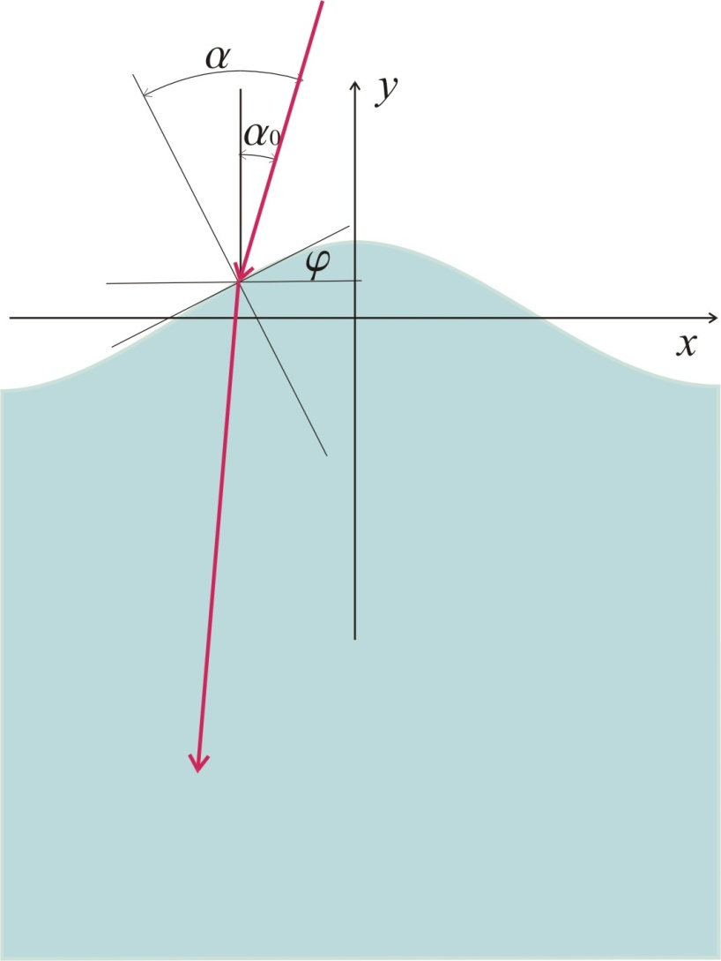
Vpadni kot
- enačba površine:
- naklon površine:
- vpadni kot:

Slide 32
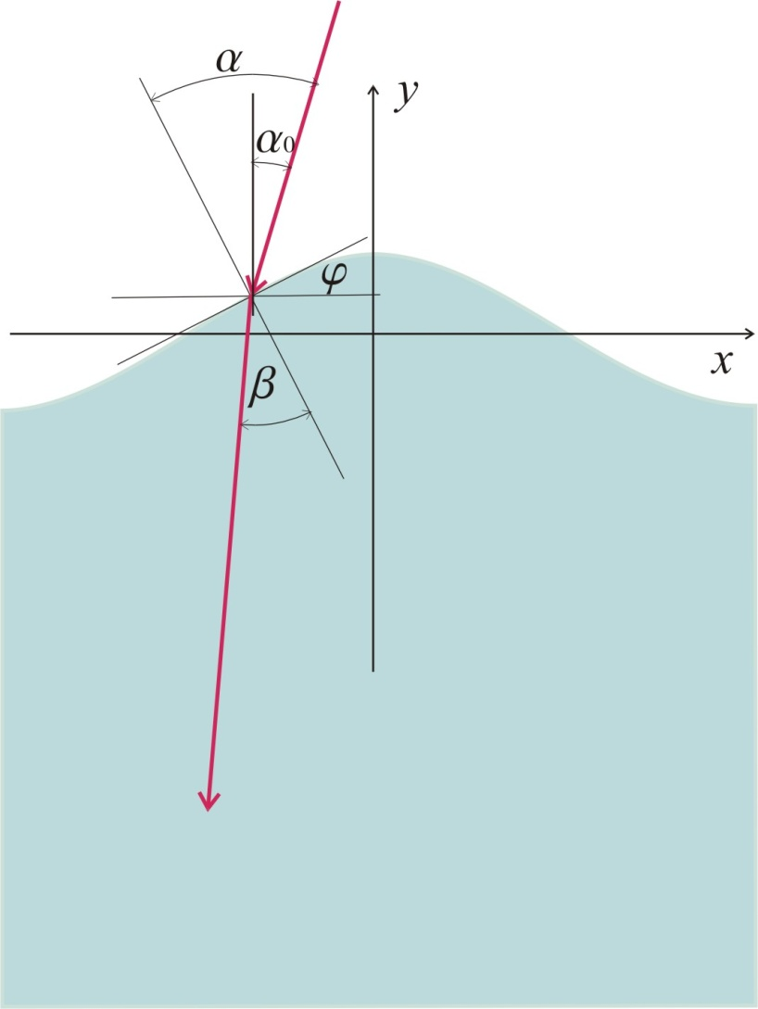
Lomni kot
- enačba površine:
- naklon površine:
- vpadni kot:
- lomni kot:
Izvesti za vsako točko

Slide 33
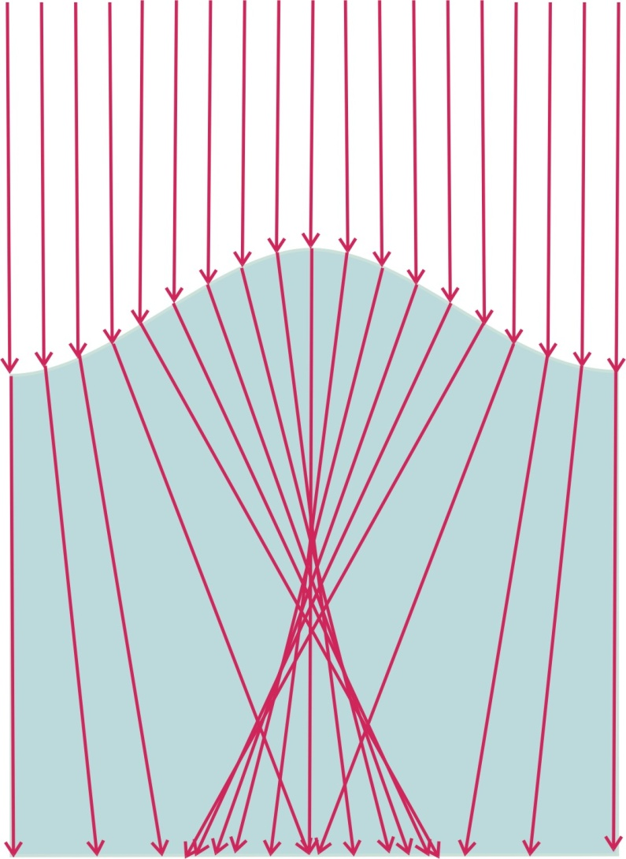
Kaj dobimo ?

Slide 34
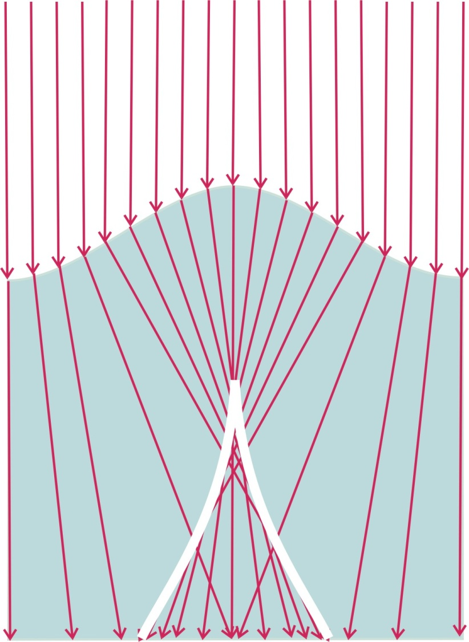
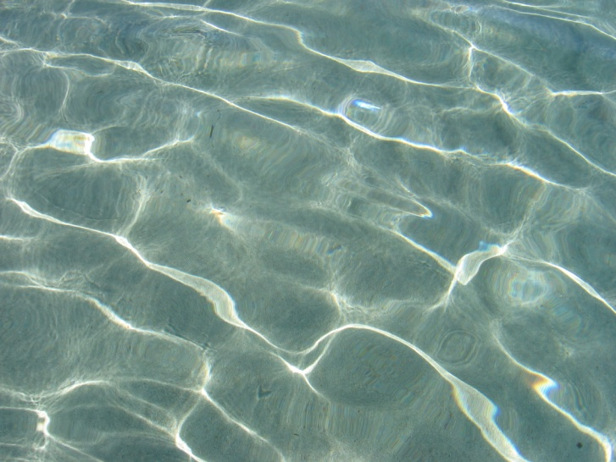
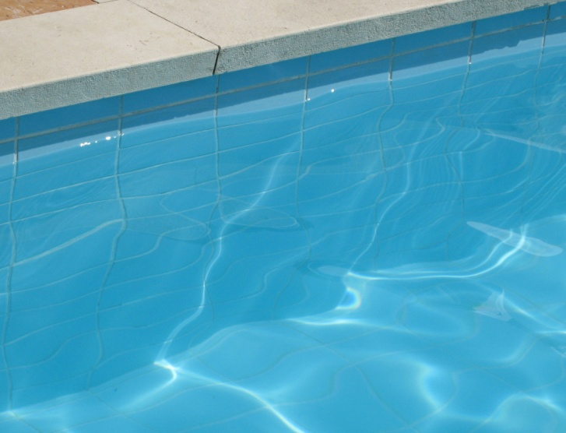
Geometrijski pristop

Slide 35


Slide 36
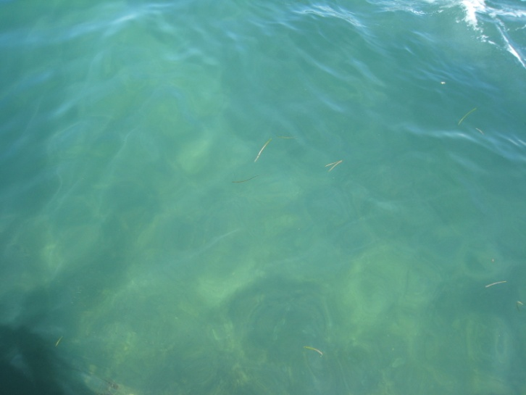
Svetlobni curki

Slide 37
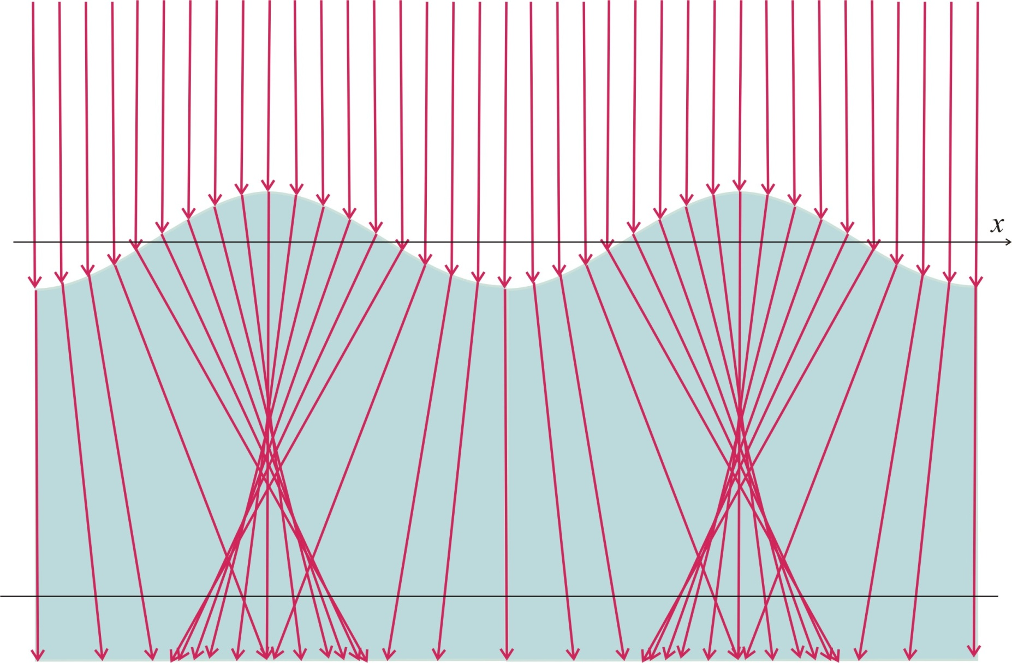

Svetlobni profil
x0

Slide 38
Model
Težave pri opazovanju v naravi
- hitro spreminjanje situacije
- nezmožnost vpliva na okoliščine
Model
- omogočiti mora opazovanje
- študij odvisnosti od spremenljivk
- razmisleki morajo biti veljavni tudi za model

Slide 39
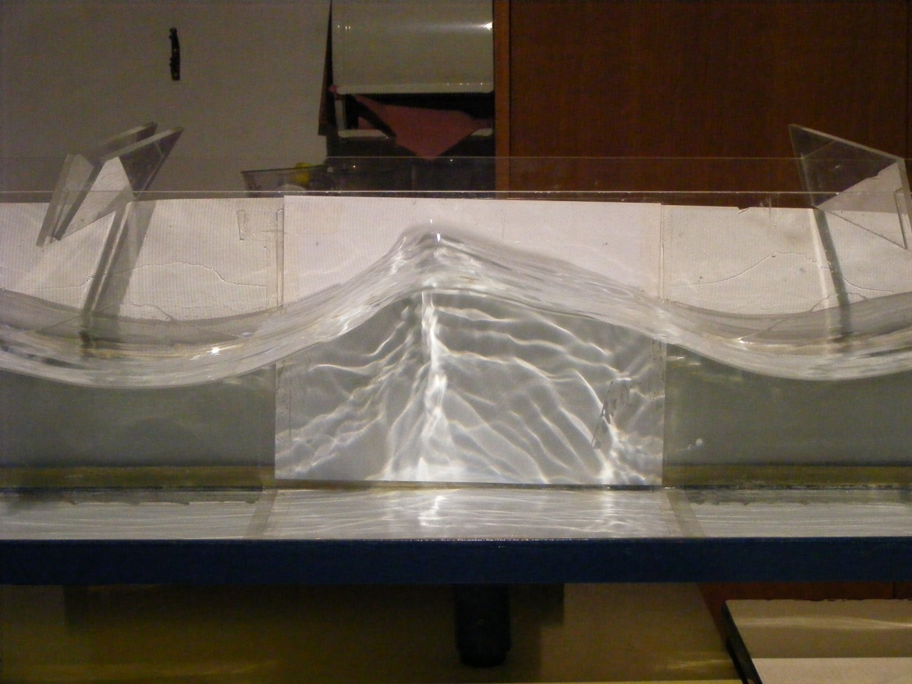
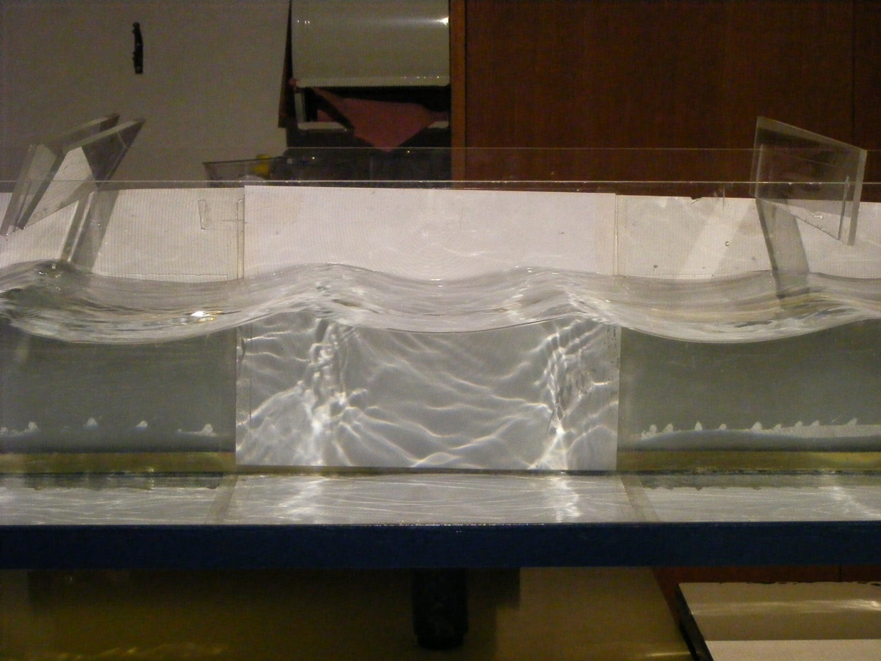
Dinamični model

Slide 40
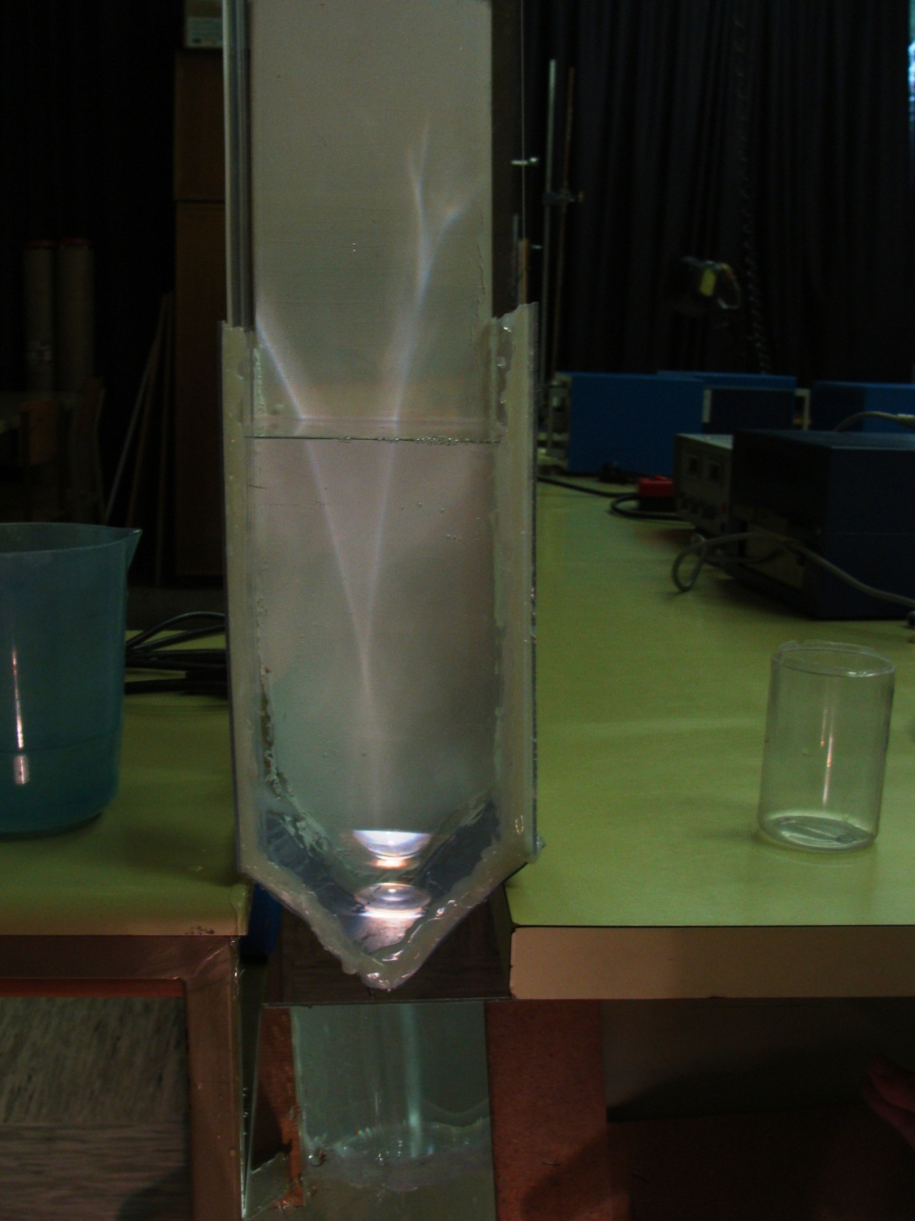
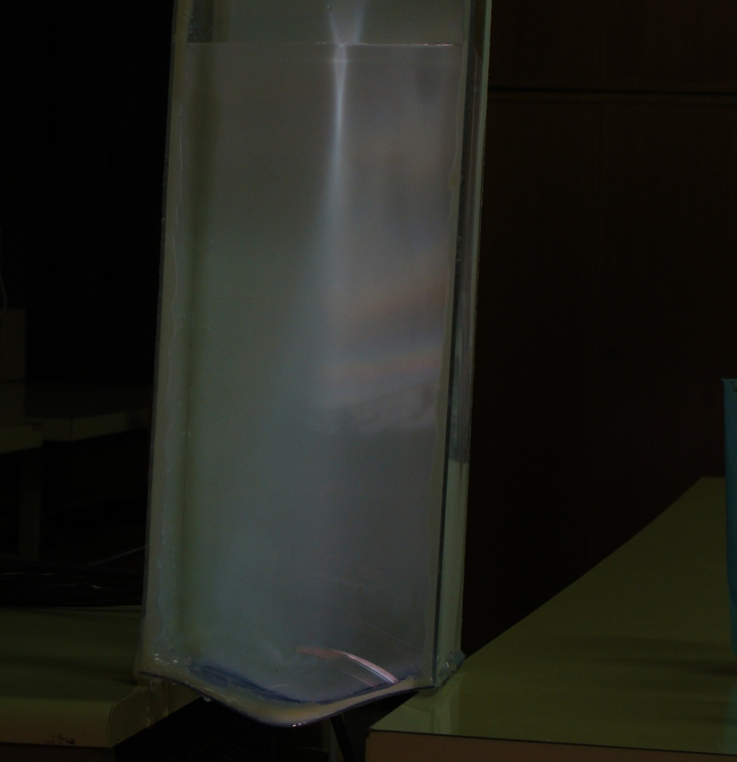
Statični model

Slide 41
Zaključek
Kaj imenujemo modeli
Modeli pojavov v naravi
Kriteriji postavitve modela
Dva primera
  Transport vode v drevesih
  Curki svetlobe pod vodo

Slide 42
Hvala za pozornost

