Slide 1
Quality assurance in Danish VET 1991 - 2015
Ljubljana 19th November 2015

Slide 2
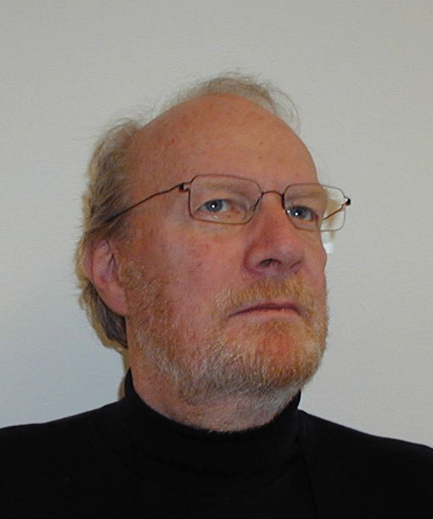
Who am I?
Name: Hans Joergen KNUDSEN
Chief Consultant
Metropolitan University College
Copenhagen, Denmark
School development projects
Knowledge sharing
Strategic competence development
Educational design

Slide 3
The basic elements of Danish VET
Danish VET
Self-governing institutions
Social Partnership
Dual system
Alternating programmes

Slide 4
Significant changes related to quality
1991 A new VET reform – very autonomous schools
1993 - New government (Social democratic) – less autonomy
1996 - Q-90 Quality-systems required (inspired by EU/NPM)
1997 – Quality is for the schools to do but must be documented
2000 – Lisbon strategy – EU influence (education in focus)
2001 – New government again (liberal)
2002 – Open Method of Coordination – more EU-influence
2011 – New government (SFR)
2012 – Government takes the lead in terms of quality
2013 – New rules for autonomy, leadership and quality and a new
VET-reform (2014)
2015 – New government again liberal)

Slide 5
The legislation 1991
1. Executive order on Vocational Education and Training (the education)
The provision and how it is related to:
The dual system
The Partnership model
2. Executive order on Vocational institutions (the institutions):
Institutions are approved as such by MoE
They are self governing institutions
Under a goal and framework system
Board of governors responsible for almost everything and accountable to MoE
Director responsible for daily operations

Slide 6
Overall management of the VET school
The school board:
Overall responsible for economy, provision, buildings and equipment, staff, approves the budget and is accountable to the MoE
6 – 14 members, majority from outside the school, 1-2 from the region and the municipality, 1-2 members are representing the staff, and 1-2 are representing the students, trade unions and employers organisations are equally represented and will normally be chairing the meetings. The director participates in the meetings but without the right to vote. The school board selects and appoints the director, and can also fire him/her again
The director:
Responsible for daily operations, provides the board with information, suggestions about the future budget and future strategy. The director appoints (or is responsible for the appointment) of all other staff-members – approved by the board.
Accountable to the board

Slide 7
The taximeter principle
Schools are paid per student (teaching taximeter)
Per square meter (building)
For being a provider (per institution)
For that amount of money they have to pay all costs:
Salaries
Building maintenance
New investments in equipment, machinery and buildings
All administrative costs
ICT
Canteens
Marketing
HR costs and quality assurance costs
Etc.

Slide 8
The general picture – after 1991
Schools were made autonomous and MoE should not interfere in what schools could handle themselves
Leaders should not tell teacher (the professionals) what to do or how to do it. They were the experts
Schools and leaders were responsible for all economy, equipment, buildings etc.

Slide 9
Expectations to the VET schools
EU
MoE
Competitors
Partners
Market
Customers

Slide 10
Political objectives for VET education
Effective – in terms of ensuring the employability – and actually lead to jobs. (Involving the social partners and other relevant stakeholders a key to adaptability of the VET programmes.)
Attractive (flexible system on a level with the more academically-oriented education programmes at upper secondary level).
For everybody (inclusion – also for immigrants and weak learners)
Adaptable (developing new solutions to the challenges of a globalising world - IT, the services and the entertainment and leisure industry etc.)
VET-schools must work accordingly
Based on that, concrete objectives are set up like 95% of all
students should have a formal educational competence by
2015

Slide 11
Major changes in legislation –
and the quality issue
1991
1996/1997
2013/2014
Education
Institutions
School-autonomy
Q90
Core products
Pedagogical leadership
Quality control
Quality assurance systems
EFQM/Excellence
Self-governing institutions
Goal and framework system
Market orientation
Buildings, machinery given
to the schools
School-boards accountable
to the ministry
Quality based on
self-evaluation
Schools decided
what to work with
and how to it
Quality is brought close
to the core-production
MoE decides what to be
focused on
Change from general systems
to the more concrete
requirements

Slide 12
From Q90 to the Excellence model (EFQM)
Enablers
Results
People
People
results
Processes
Leadership
Policy and
strategy
Customer
results
Key
perfomance
results
Partnerships
and resources
Society
results

Slide 13
Questions to the outcome
Input
Output
Out-come
Activity
Papers, and
resources
Teaching
and learning
Satisfaction and
loyalty
?
Marks
Economy

Slide 14
The Excellence model (EFQM)
Enablers
Results
People
People
results
Teacher
Processes
Leadership
Policy and
strategy
Customer
results
Key
perfomance
results
Stuff
Student
Parnerships
and resources
Society
results

Slide 15
First step – quality assurance
School-director
Quality-assurance
Paperwork
Leader 1
Leader 2
Leader 3
Leader 3
Administrative leadership
For the school and to
be documented on the
web-site
And………?

Slide 16
Next step quality assurance
School-director
Quality-assurance
Paperwork
Leader 1
Leader 2
Leader 3
Leader 3
For the school and to
be documented on the
web-site
Satisfaction-surveys
could be used in discussions
between leaders and the
teachers
Knowledge sharing – bench-
learning
Administrative leadership

Slide 17
MoE takes the lead
Input
Output
Out-come
Activity
Paper, and
resources
Teaching
and learning
Satisfaction and
Loyalty
Coordinated efforts
- same system
Marks?
Economy?
Pedagogical-
didactical
strategy
Competence
development
Pedagogical
Leadership
IT
Diff instruction
Theory-practice
Feedback
More students
Reduced dropout
Learning

Slide 18
A new VET-reform (2014), and new objectives
More students must choose VET directly after elementary school
More students must complete VET
VET must challenge all students in order to make them as good as the can be
Confidence in and well-being at the vocational training institutions must be strengthened
So what can be done?

Slide 19
A new Ministry of Education
Conferences learning from schools
New quality procedures
Civil servants
Research projects on important issues
Information and knowledge
Development projects producing emperical data
Read books and visit other countries
Pedagogical experts
New initiatives for improvement of VET
Learning consultants
European experience and agreements

Slide 20
The Excellence model
Action plans
for enhanced
completion
Differentiated
instruction
ICT
Theory-practise
Enablers
Results
Competence
development
More students
Start
More students
complete
People
People
results
Pedagogical
leadership
Teacher
Processes
Leadership
Policy and
strategy
Customer
results
Results
Didactical-
pedagogical
strategy
Stuff
Student
All students
learn as much
as they can
Parnerships
and resources
Society
results
Confidence
well-being

